Slide 1
Will It Float?
Science Masterpiece

Slide 2
Video Link

Slide 3
Buoyancy
Objects that can float are buoyant.
These objects can float because they are less dense than water.
Density is a measure of how close together an object’s molecules are.
Water can only hold up things that are less dense than itself.
Things that are denser than water will sink.

Slide 4
Vocabulary
Buoyancy
The ability of an object to float.
Density
How close together an object’s molecules are.
Displacement
The amount of water that is moved by an object when it is placed in water.
Float
To be held up or supported by a liquid.
Sink
To fall below the surface of something.

Slide 5
Experiment Time

Slide 7
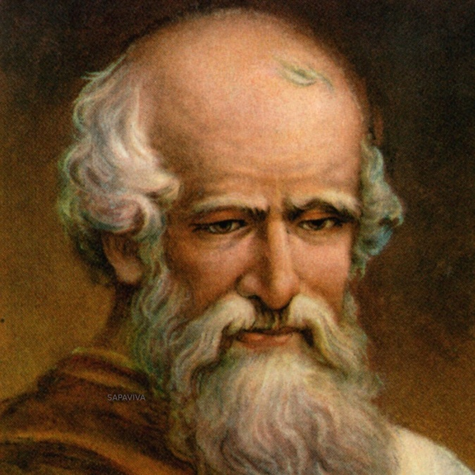
Conclusion
In ancient Greece, there was a scientist named Archimedes who found that when an object is put in water it displaces or moves some of the water.
If the object weighs less than the water, or is less dense than the water, the object floats.
If it weighs more than the water, or is denser than the water it displaces, the object sinks.
This is known as Archimedes' Principle or the Law of Buoyancy.

