Slide 1
Skeletal System
Science masterpiece

Slide 2
Skeleton

Slide 3
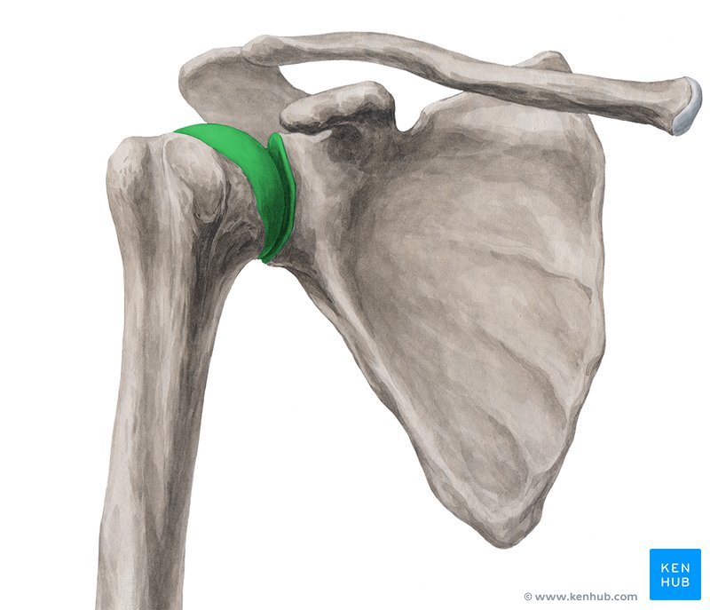
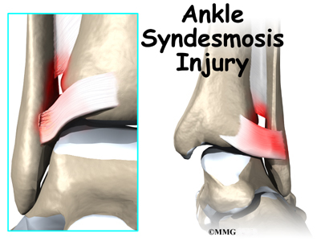
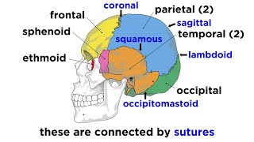
Joints
Joints are when 2 or more bones come together and help perform movement.
They can be classified by structure and by function.
There are joints that don’t move, slightly move, and freely move.
Immovable
Slightly Moveable
Freely Moveable

Slide 4
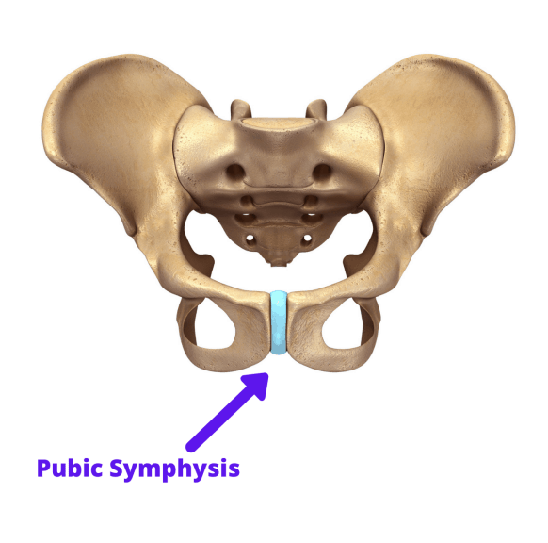
Immovable Joints
These joints are joined together by very strong connective tissue fibers.
Examples: Sutures and Pelvic Arch
Dense Fibrous
Connective Tissue

Slide 5
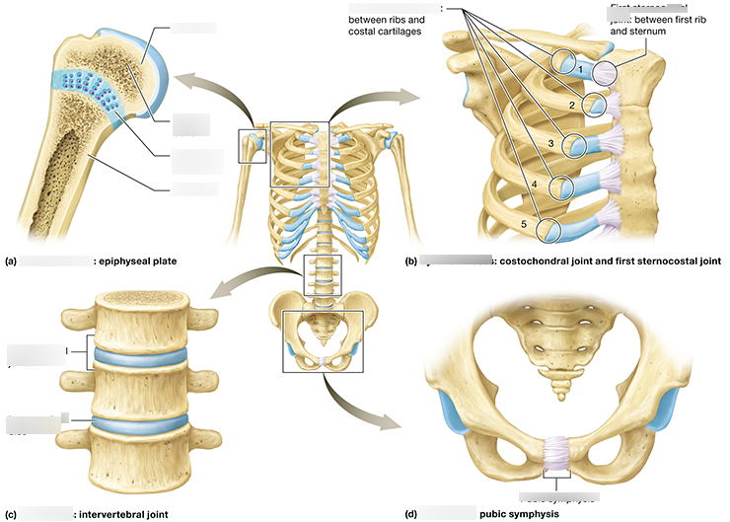
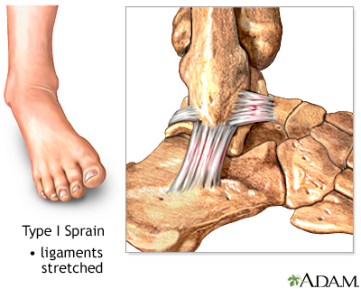
Slightly Moveable Joints
These joints are connected by a ligament; a cord or band of fibrous tissue, or cartilage.
They lack a joint cavity.
The amount of movement depends on the length of the connecting fibers.
Example: Tibia and Fibula

Slide 6
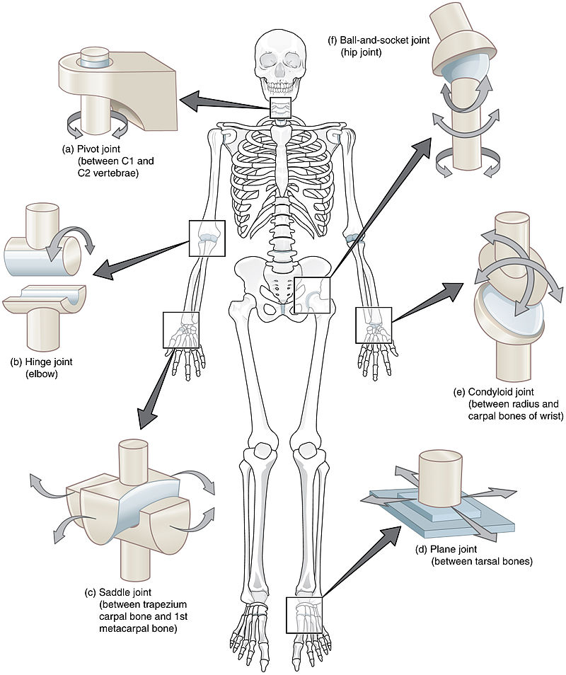
Freely Moveable Joints
These joints have articulating surfaces and joint cavities.
The bones have a special coating to help them move in the joint. The joint also has a special fluid to help the bones glide easily over each other.

Slide 7
Ball and Socket Joint
The spherical of one bones sits in the cuplike socket of another bone.
These joints allow multiaxial movement.

Slide 8
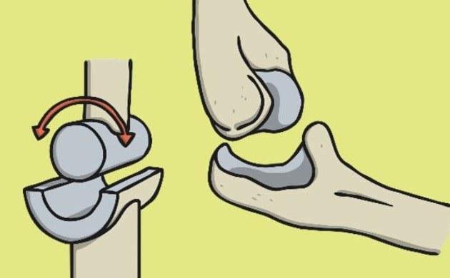
Hinge Joint
A cylindrical shaped bone fits in a trough shaped surface of the other bone.
Motion is in a single plane and looks like that of a door hinge.
Example: Knee and Elbow

Slide 9
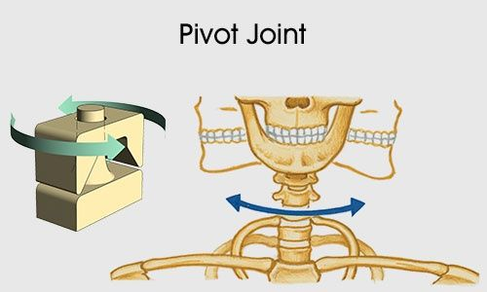
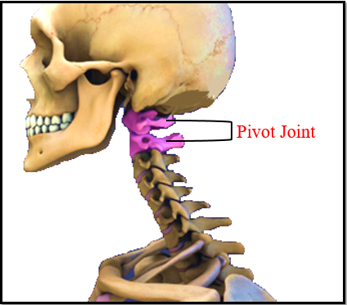
Pivot Joint
The rounded end of one bone fits into the sleeve or ring of the other bone.
The movement is uniaxial rotation of one bone around its own long axis.
Example: C1 and C2 of the spine

Slide 10
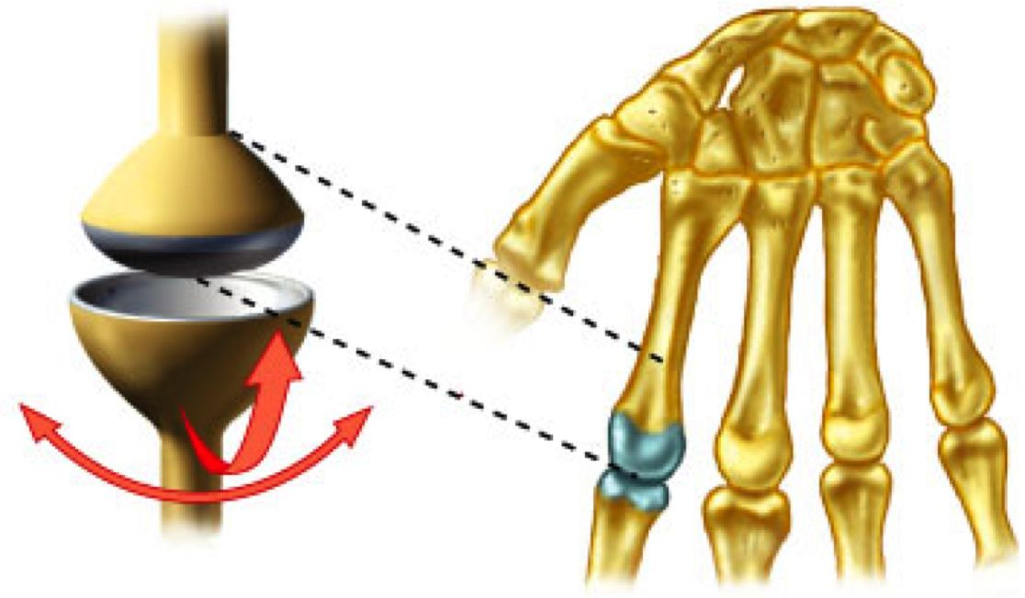
Condyloid Joint
A knuckle-like or oval shaped surface of one bone fits into a concave surface of another bone.
Both surfaces are oval shaped.
These biaxial joints allow for angular motions: flexion and extension, abduction and adduction, and circumduction.
Example: Knuckles

Slide 11
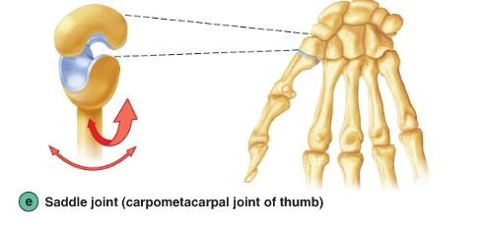
Saddle Joint
Similar to Condyloid but they allow for greater movement.
The joint surfaces have both concave and convex surfaces, making it shaped like a saddle.
Example: The thumb joint.

Slide 12
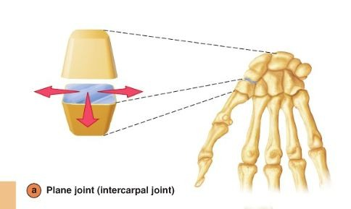
Plane Joint
The joint surfaces are nearly flat.
This allows for only short gliding movements; gliding does not allow for rotation around any axis.
Example: Plane joint of the thumb.

Slide 13
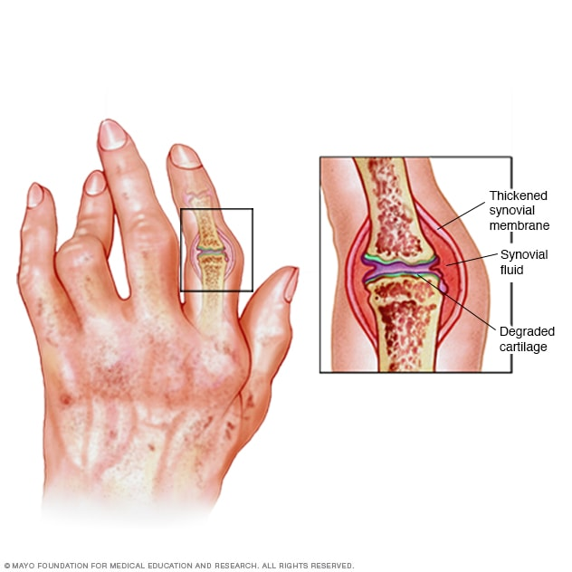
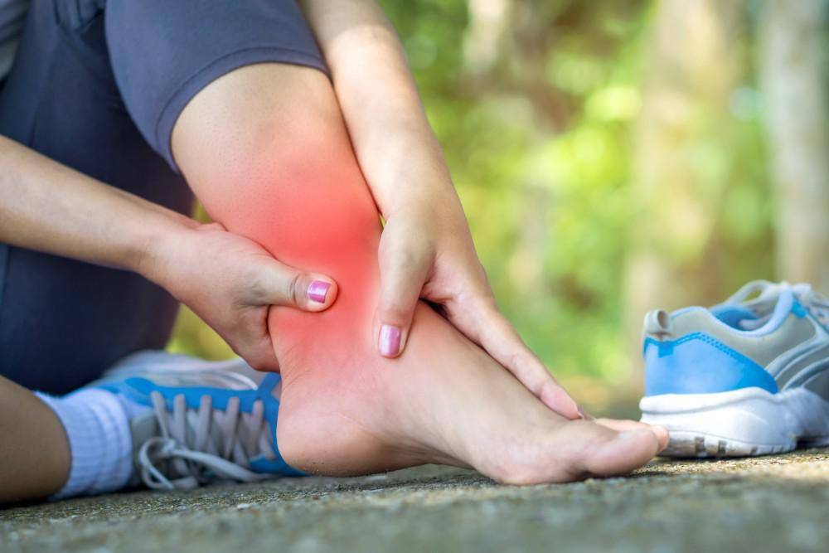
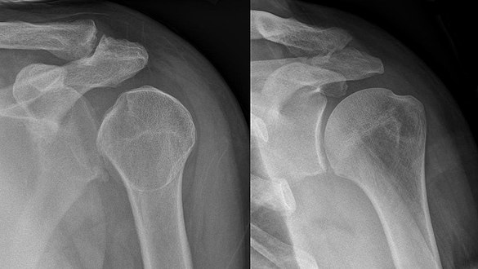
Common Joint Injuries
Sprains – Ligaments around a joint get stretched or torn. Common sites are ankle or knee.
Dislocations – Occur when bones are forced out of alignment, they usually go along with a sprain. Common sites are shoulders, fingers, thumbs and jaw.
Arthritis – There are over 100 different types. It can cause inflammation or degeneration. Ex: Osteoarthritis, Rheumatoid Arthritis, and Gouty Arthritis.

Slide 14
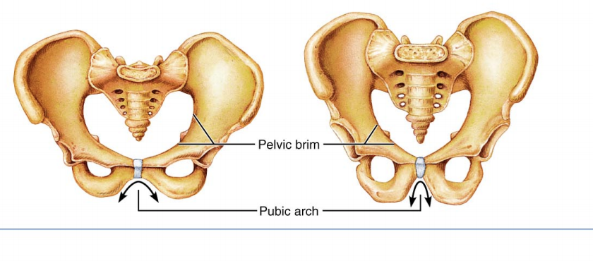
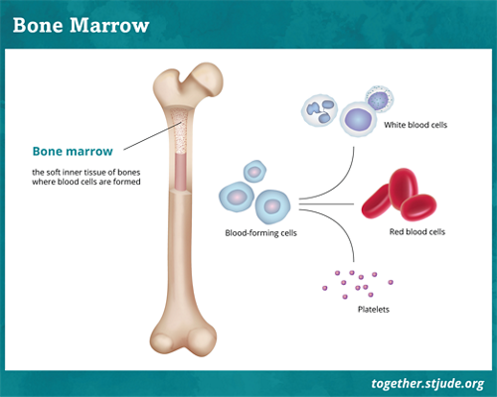
Fun Bone Facts
Scientist can tell if a skeleton is male or female based on the pelvic bone.
Our red and white blood cells are made in our bones (bone marrow).
Ounce for ounce, bone is stronger than steel. One cubic inch of bone can withstand the weight of five standard pickup trucks, give or take a few pounds.
It takes about 4,000 newtons of force (900 lbs) to break the typical human femur.

