Slide 1
Muscle Contraction
Science Masterpiece

Slide 3
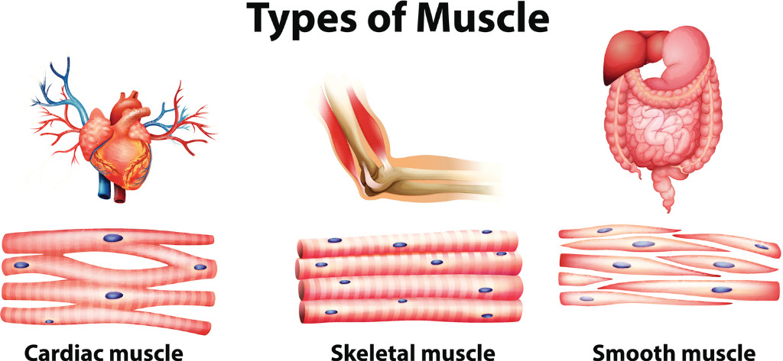
Muscle Types
Muscles are a group of elastic fibers that hold the body together and control all movement.
There are 3 types of muscles:
Muscles can be voluntary or involuntary.
Cardiac and Smooth Muscle are involuntary; they work with out you thinking about it.
Skeletal Muscles are voluntary; your brain makes the muscles move.

Slide 4
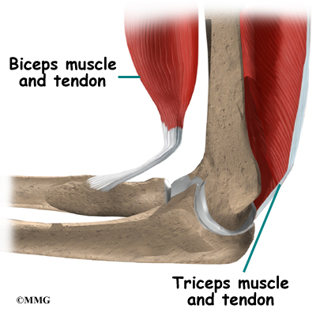
Muscle Facts
Skeletal Muscles attach to your bones by tendons.
Tendons are tough, fibrous cords.
Muscles work in pairs to help your body move.
One muscle contracts and the other relax.
We have more then 600 muscles in our body.

Slide 5
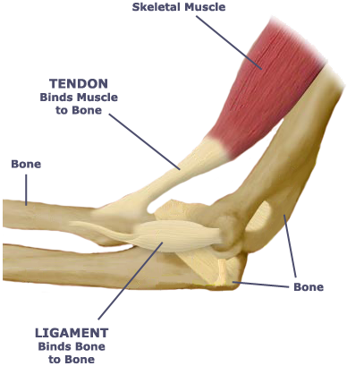
Tendons and Ligaments
Ligaments are similar to tendons, but the connect bone to bone.
Fibers in muscles or tendons can get torn. These injuries are called “Strains” or “Pulls”
These injuries to Ligaments are called “Sprains”.
Most “Strains” heal on their own with rest and ice packs.

Slide 6
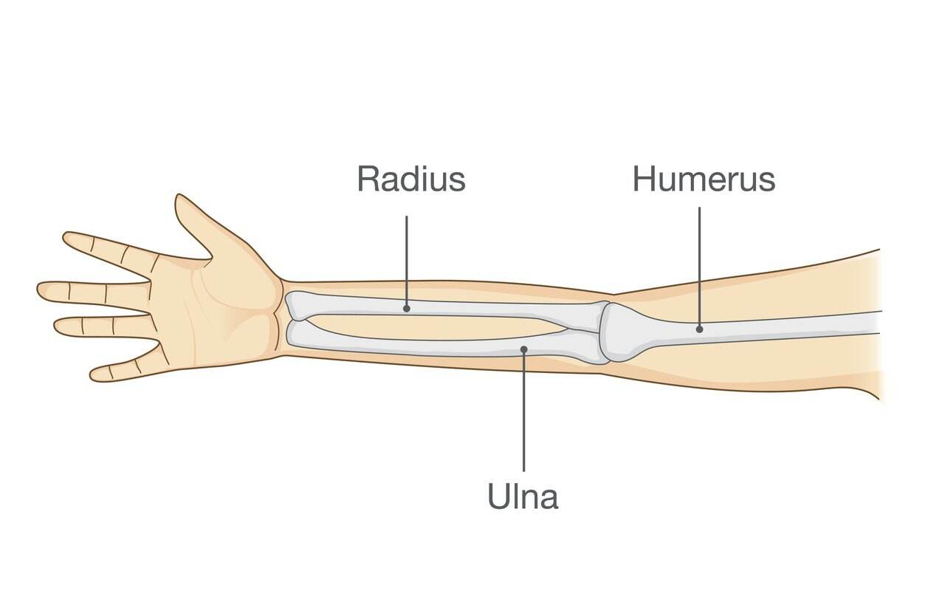
Anatomy of the Arm
There are 3 bones that make up the arm.
The largest and upper bone is the Humerus.
The 2 smaller bones connecting to the Humerus are the Ulna and Radius.
The Radius is on the side with your thumb.
The Ulna is on the side with your pinkie.

Slide 7
Muscles of the Arm
The 2 major muscles of the upper arm are the Biceps and Triceps.
These muscles work in pairs. When you flex your arm, your Biceps contract and Triceps relax.
When you extend your arm, your Biceps relax and your Triceps contracts.

Slide 8
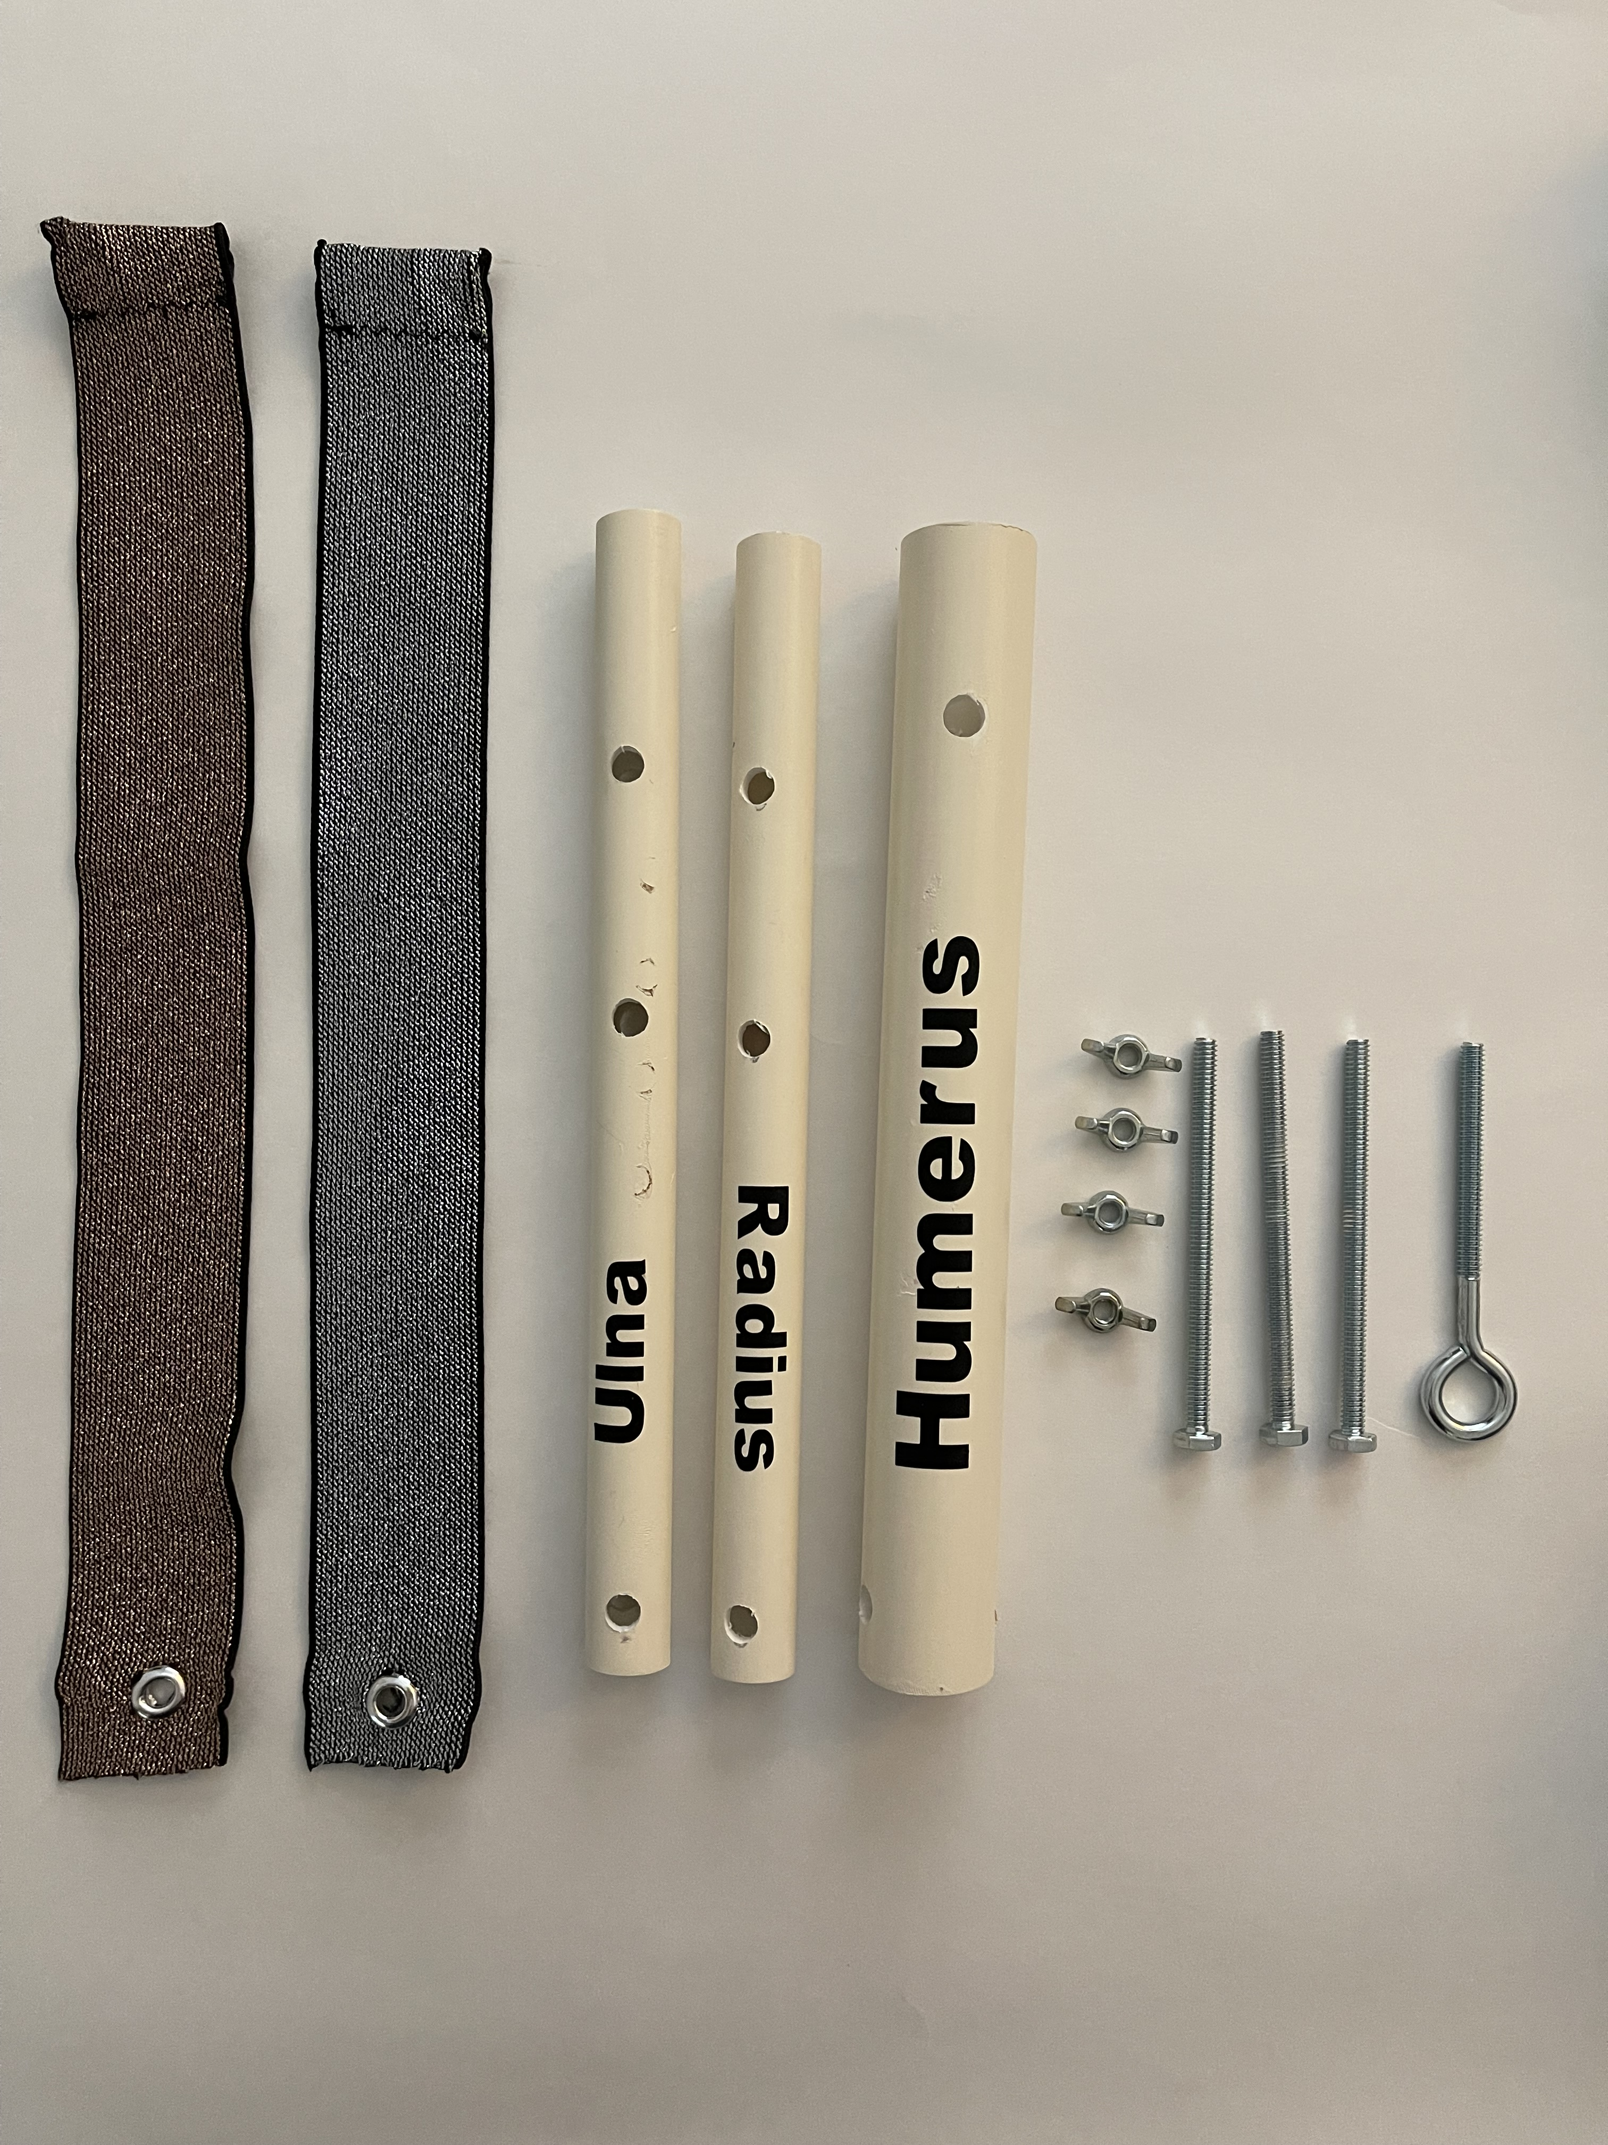
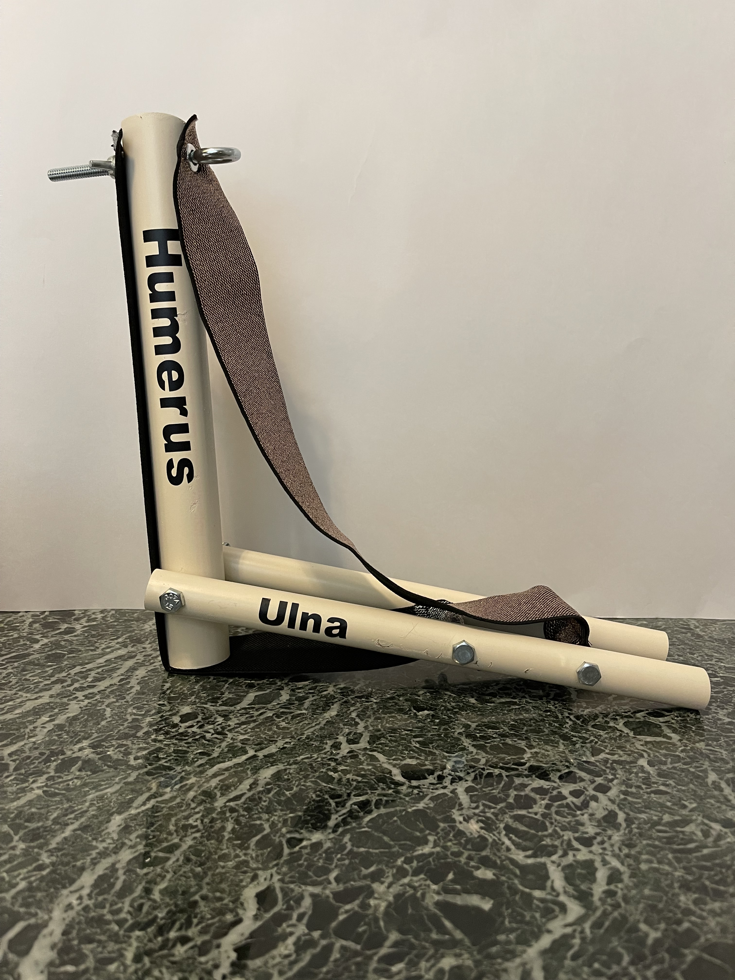
Experiment Time
Build an Arm Model
Once Constructed, observe the contraction and relaxation of the muscles with the flexion and extension of the arm.

Slide 9
Conclusion
When the Ulna and Radius flex towards the Humerus the biceps contracts and the triceps stretches.
How did this model work like your arm?
What would happen if one muscle doesn’t work properly?

