Slide 1
Wassily Kandinsky
December 16, 1866 – December 13, 1944

Slide 3
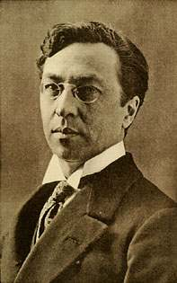
life of wassily kandinsky
Born in Moscow Russia
As a child he was fascinated by color
Studied Law & Economics in college
He didn’t begin studying art until he was 30 years old
In 1933 he moved to France where he lived the rest of his life

Slide 4
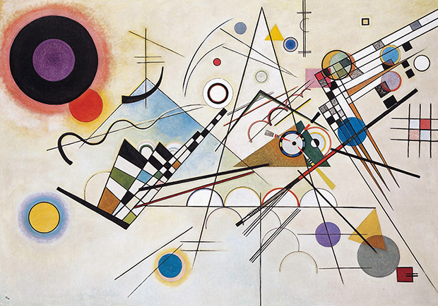
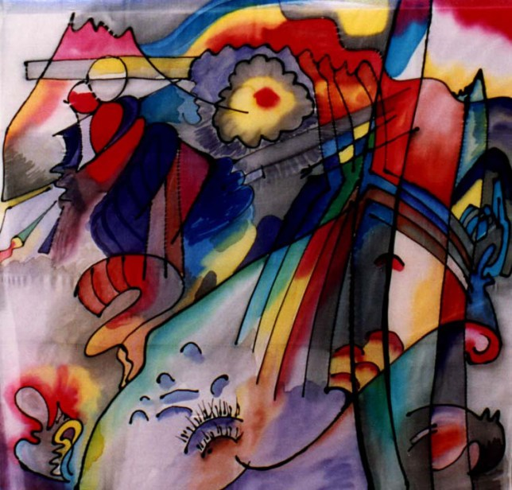
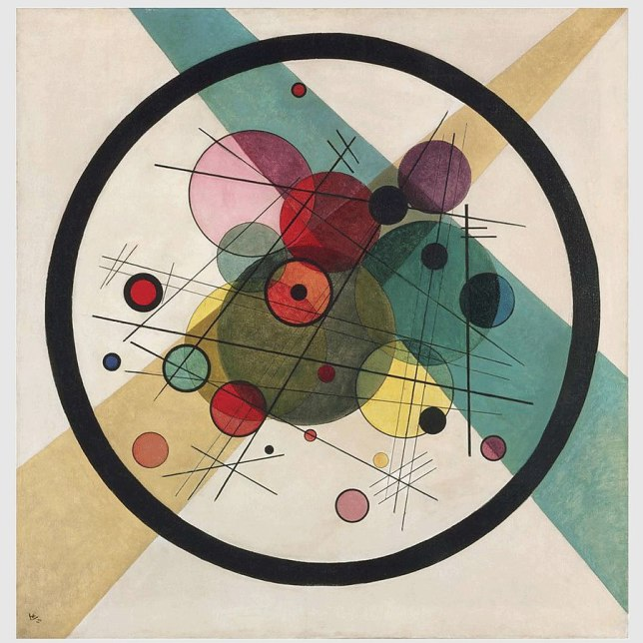
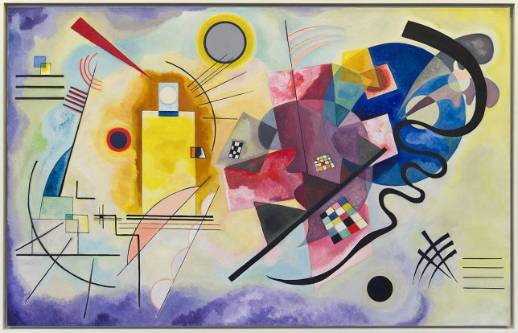
Art work
Kandinsky was inspired by Monet
Known as the father of abstract art
Vassily Kandinsky, Composition VIII, 1923, New York
Vassily Kandinsky, 293, 1913
Vassily Kandinsky, Yellow-Red-Blue, 1925
Vassily Kandinsky, Circles in a Circle, 1923

Slide 5
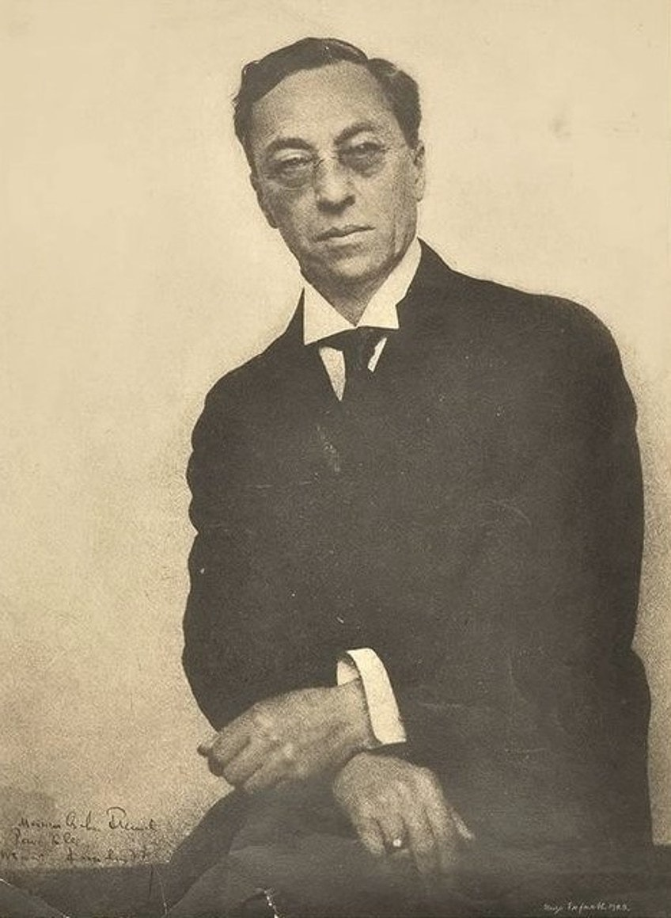
Wassily was an artistic idealist
He always experimented with new materials and processes, even used scrambled eggshells sometimes
He didn’t paint reality, he replaced reality with objects, patterns & color

Slide 6
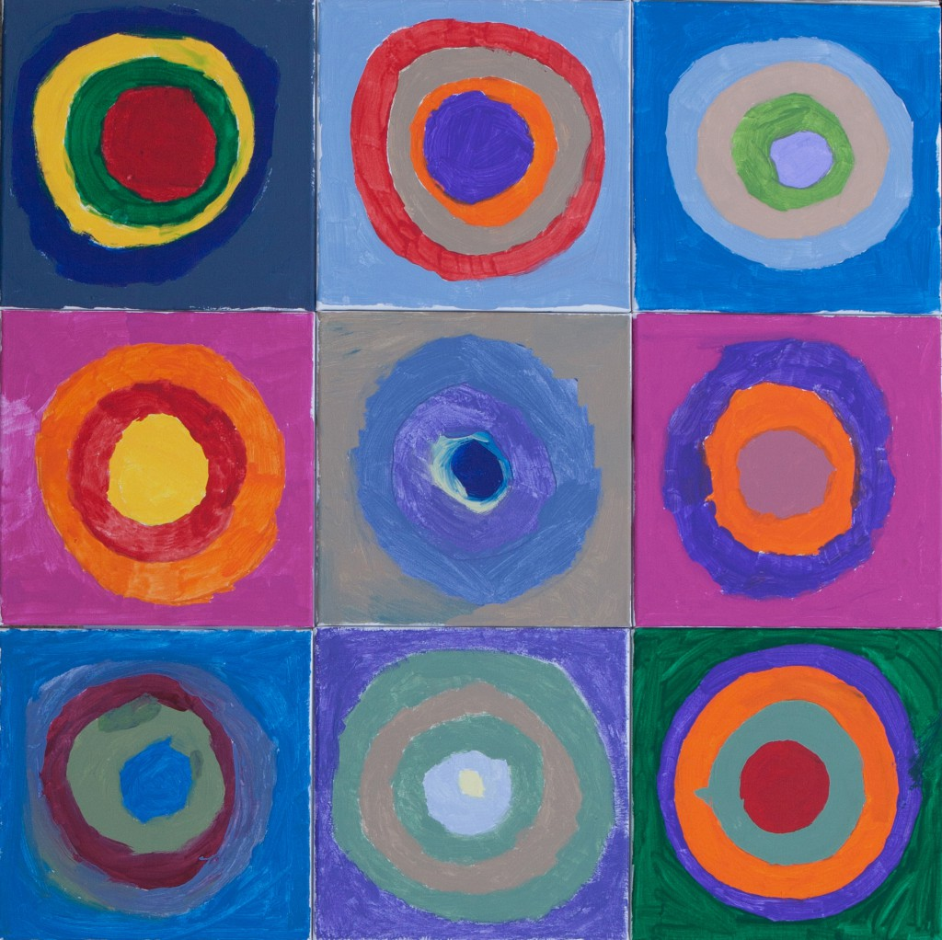
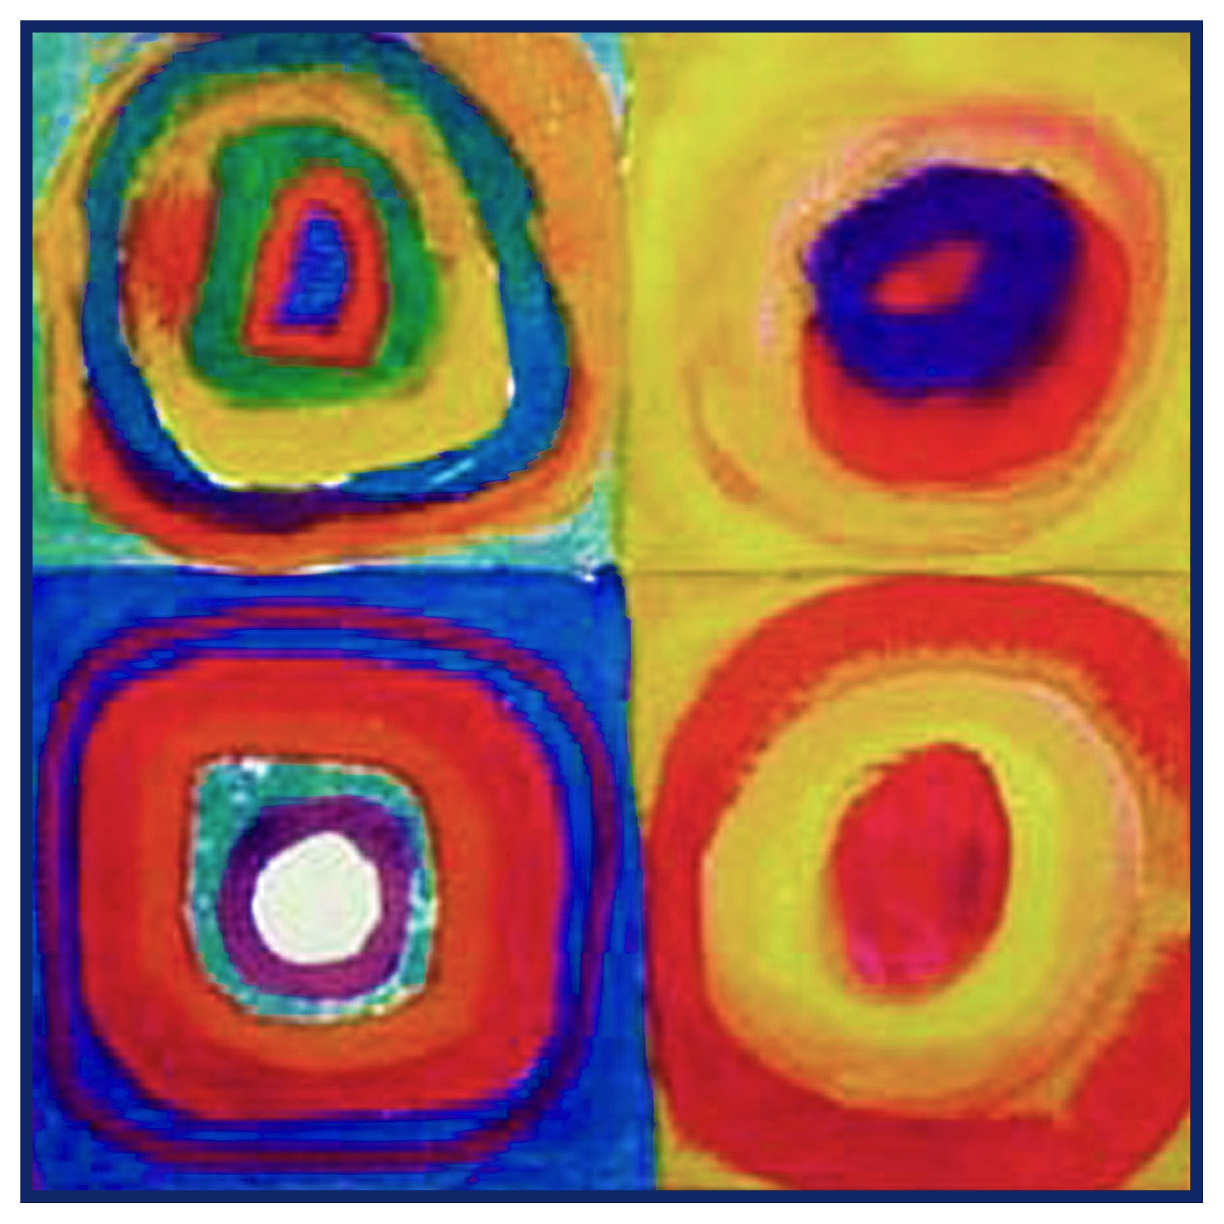
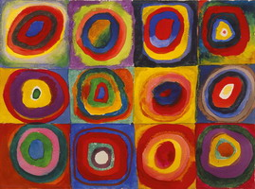
Today’s art lesson
Colorful squares with circles

