Slide 1
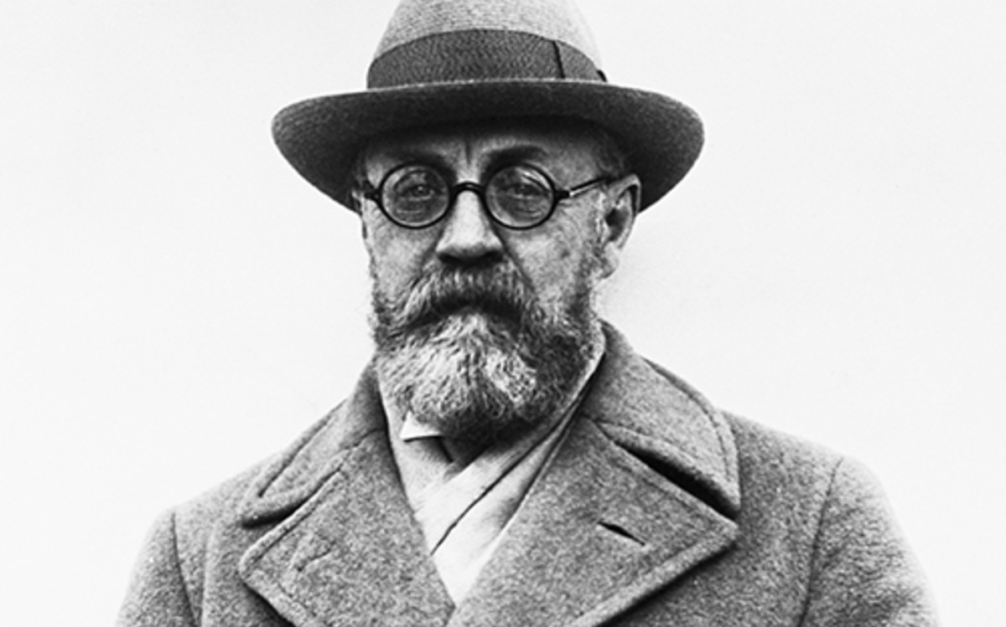
Henri Matisse
December 31, 1869 – November 3, 1954

Slide 2
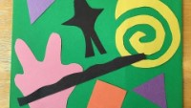

Slide 3
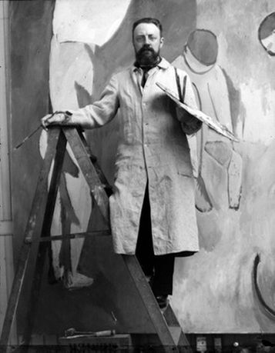
Life of Henri Matisse
Henri Matisse was born on December 31, 1869 in Nord, France
In 1887 he went to Paris and studied to become a lawyer
He first started to paint in 1889 when his mother gave him paints to keep him busy while he was recovering from appendicitis
He decided that painting was “a kind of paradise” and he quit being a lawyer in favor of being an artist
Matisse began as a very poor young artist and often did not have enough money for food. He would eat only rice so that he could afford his paint and props.

Slide 4
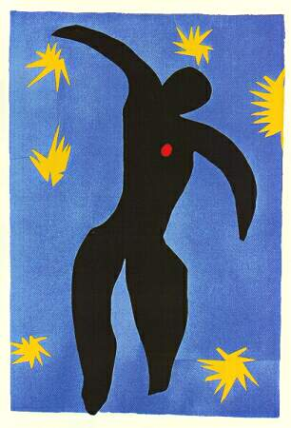
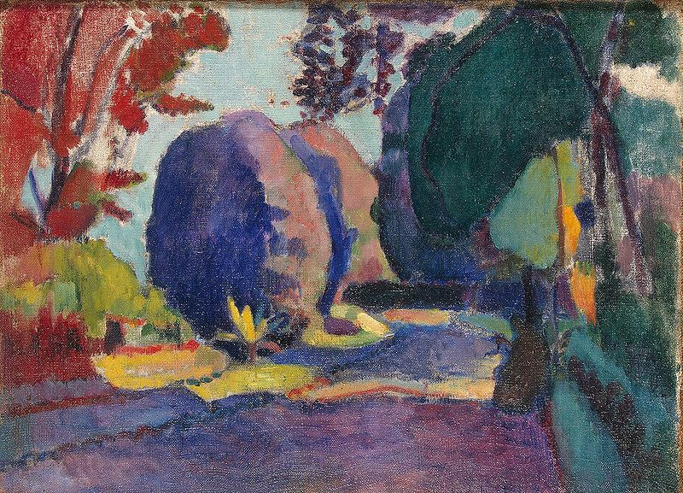
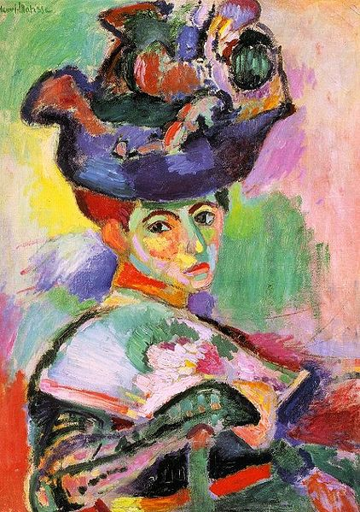
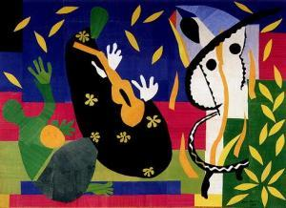
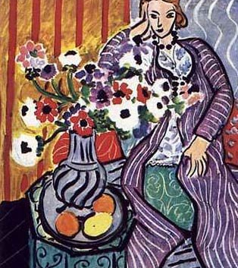
ART WORK
La Chute d’Icare (1947)
Matisse was inspired by the work of Vincent Van Gogh, which transformed his style
He began to be successful in his career
He made enough money to buy a home
He had lots of tropical birds as pets and let them fly free around his home!
Luxembourg Gardens (1905)
Woman with a Hat (1905)
The Purple Robe (1937)
The Sorrows of the King (1952)

Slide 5
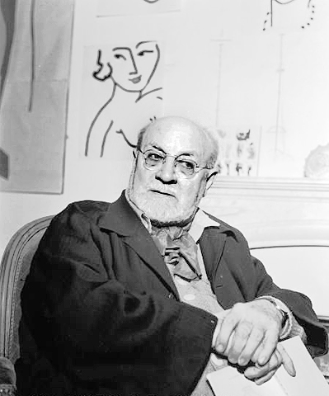
Matisse played the violin and warmed up his fingers for painting by playing the violin for hours
In 1939 Matisse had surgery and afterward used a wheelchair
He started making collages from cut paper, which he called “Painting with scissors”

Slide 6
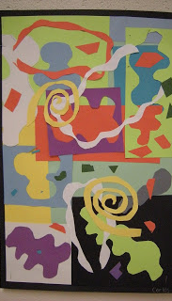
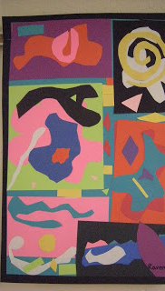
Today’s Art Lesson
Painting with Scissors!
Use your scissors to cut fun shapes from lots of different colors
Glue them to create your masterpiece!

