Slide 1
BLACK BULL
AT THE LASCAUX CAVES IN FRANCE
STONE AGE ART

Slide 3
Caves are Located in France all the way across the Atlantic Ocean
You are here!

Slide 4
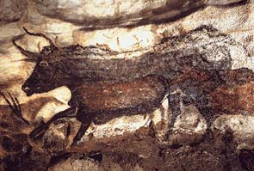
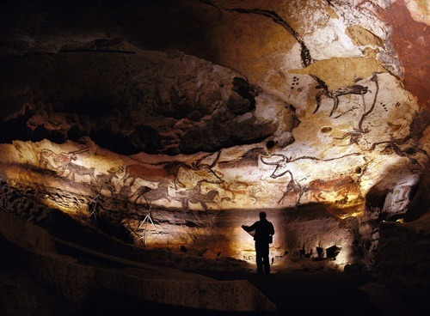
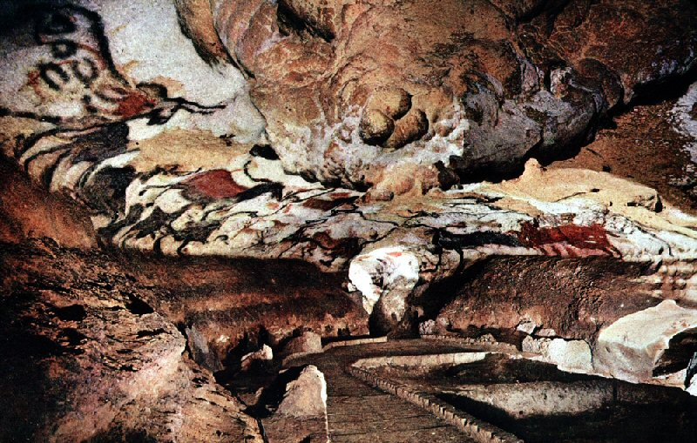
ART WORK
Cave Drawings are the oldest art in the world!

Slide 5
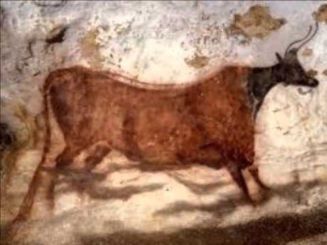

Slide 6
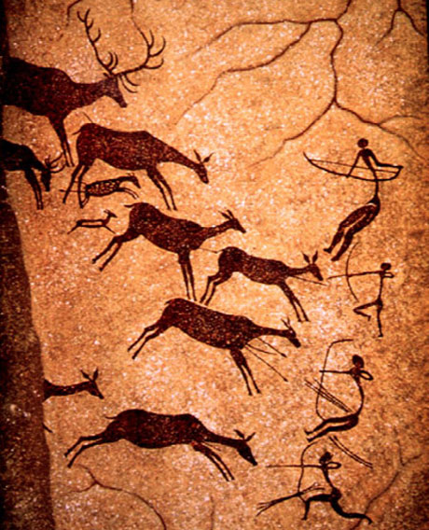
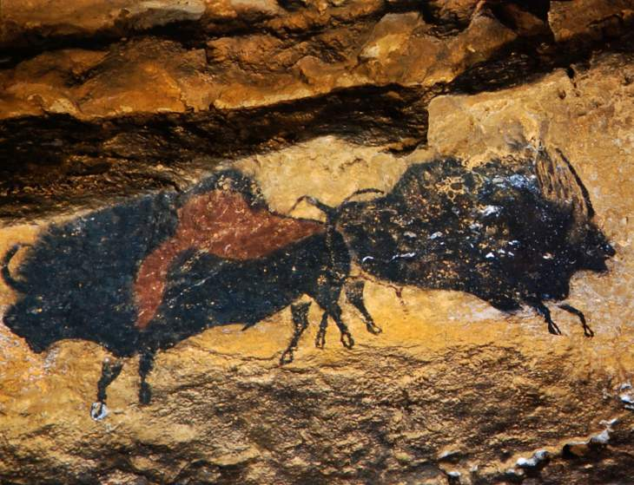
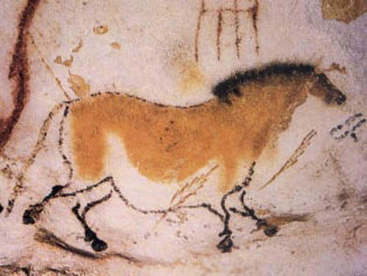
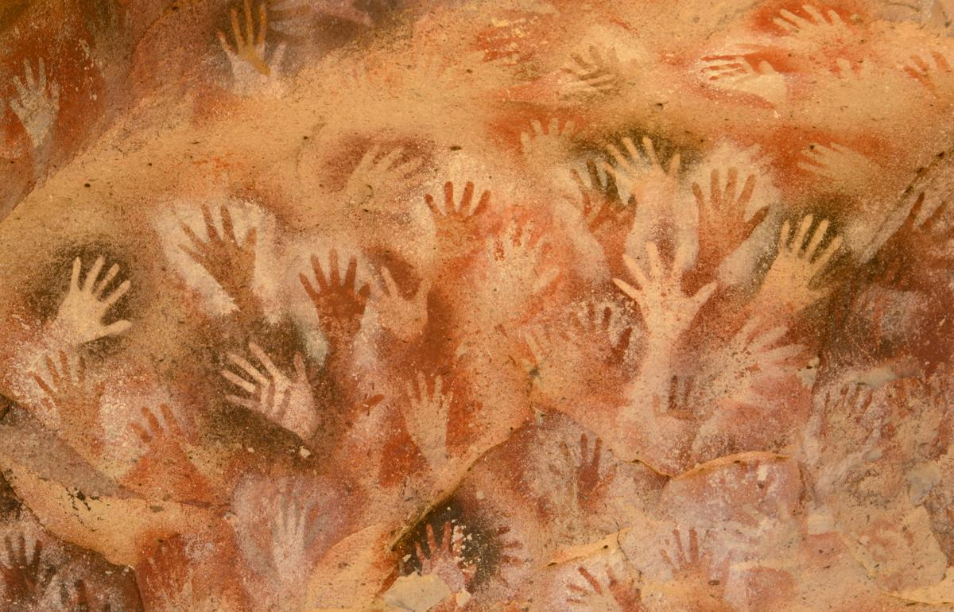
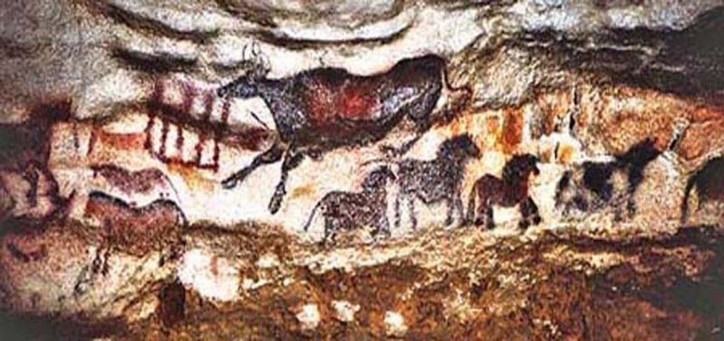
There are over 2000 drawings!
They used leaves or fur as their paint brushes!

Slide 7
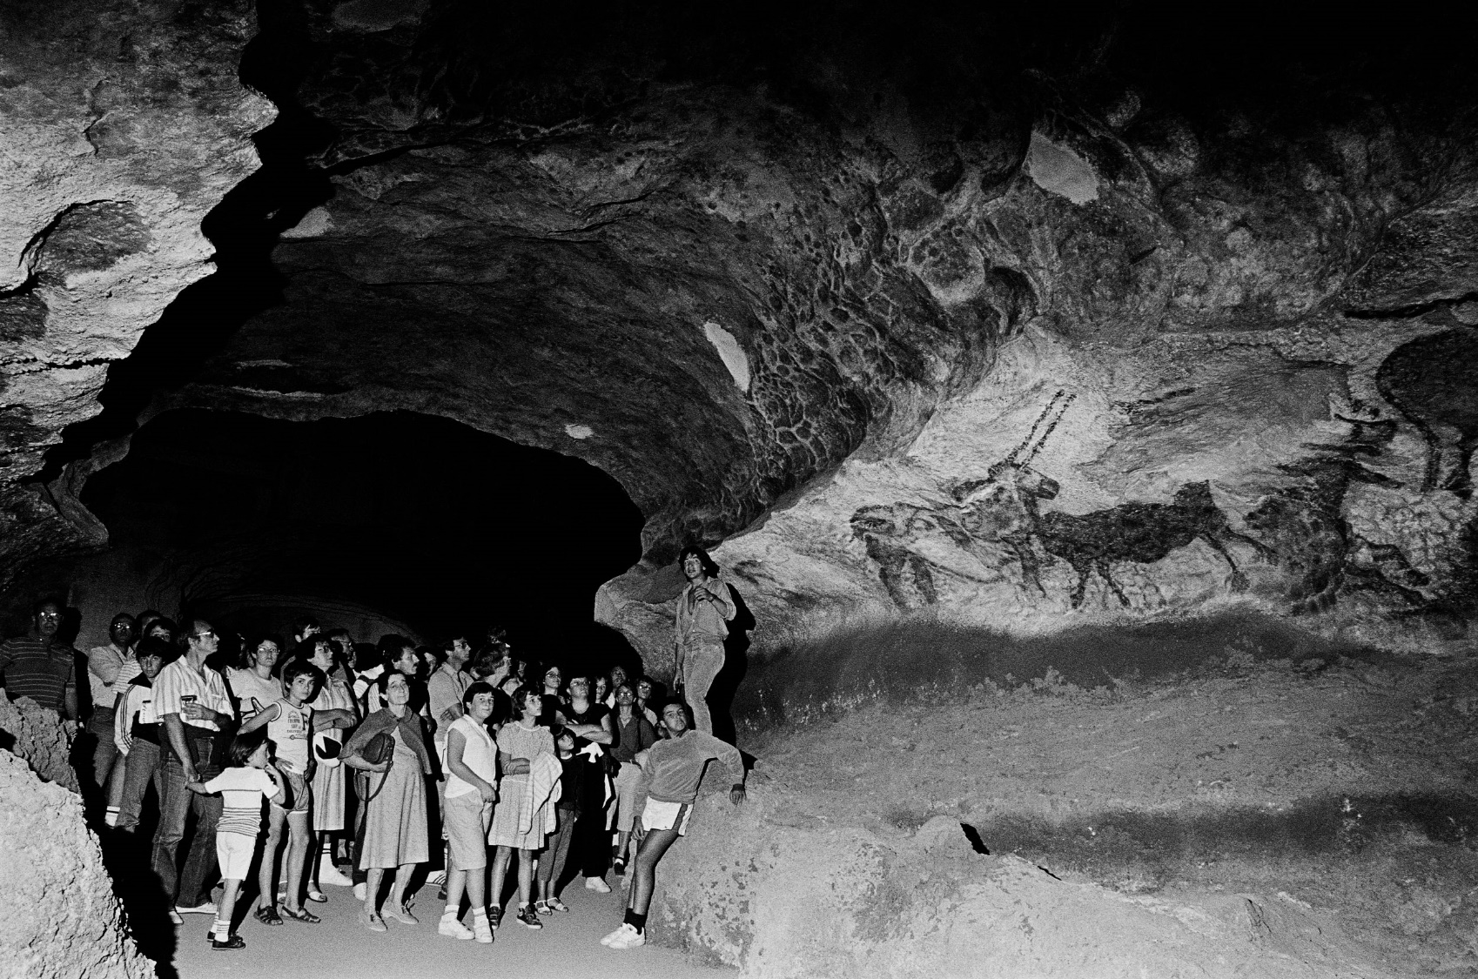
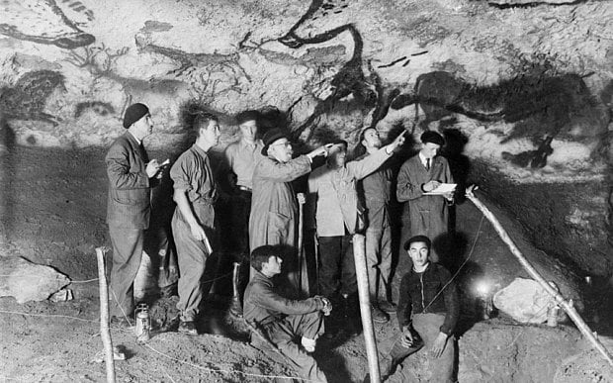
Sadly, visitors are no longer allowed in the caves

Slide 8
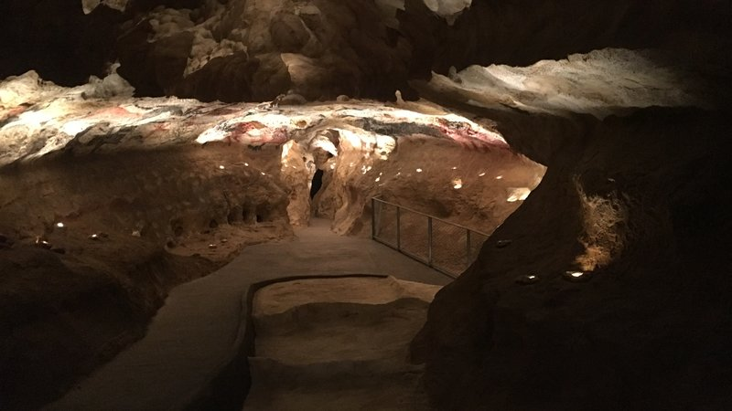
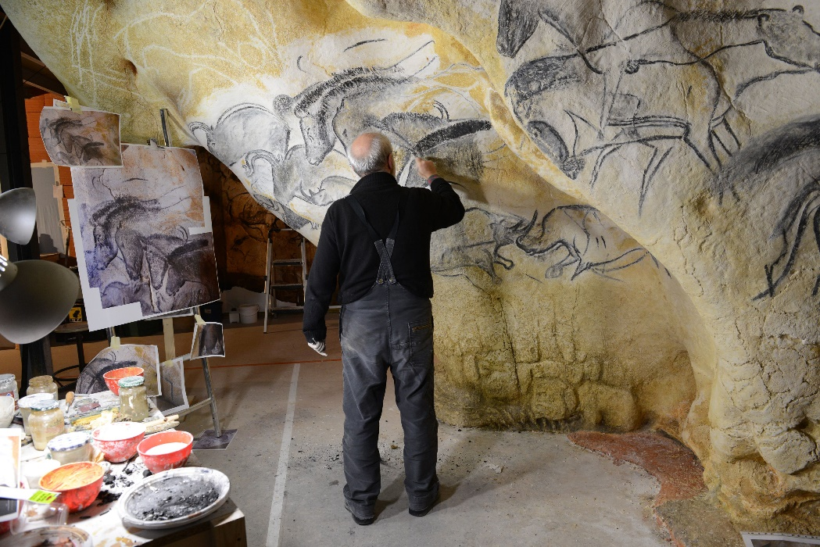
Instead they have created a Replica Of The Lascaux Cave Drawings

Slide 9
Discussion…
1. Who discovered the caves?
2. Where are they?
3. How many pictures are there?
4. What did they use to paint the cave drawings?
5. Can we visit the real caves today? Why not?

Slide 10
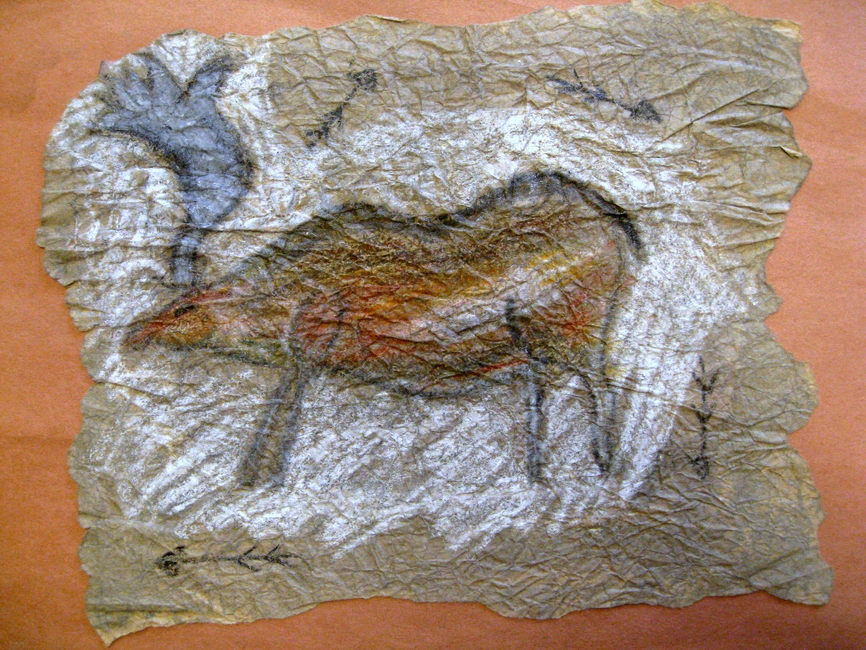
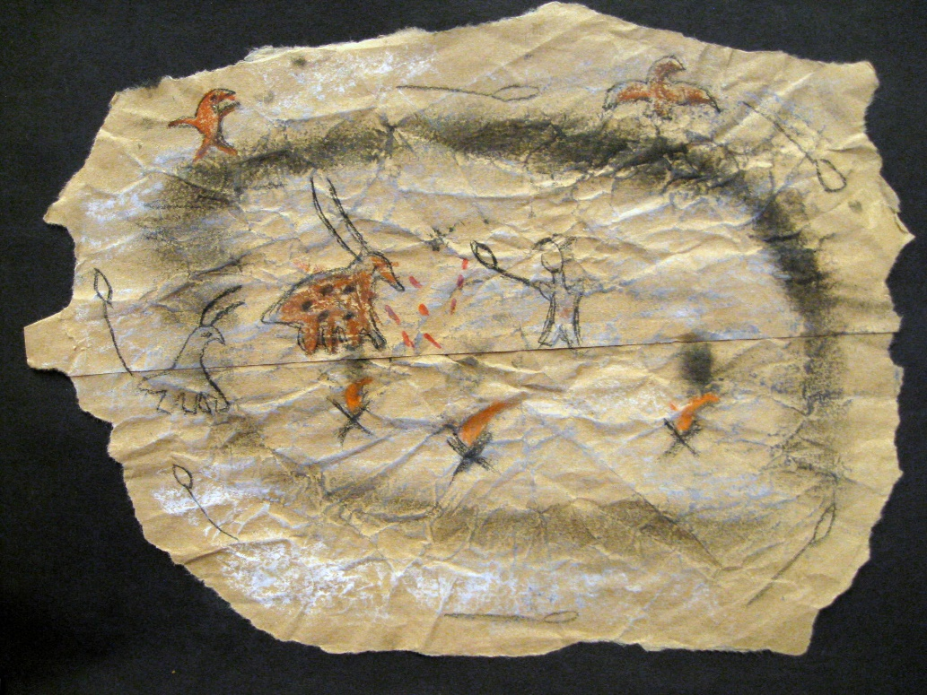
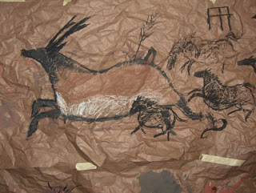
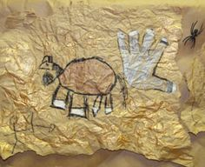
Today’s Art Lesson….
Cave Drawings

Slide 11
