Slide 1
How Do Molecules Move?
Science Masterpiece

Slide 2
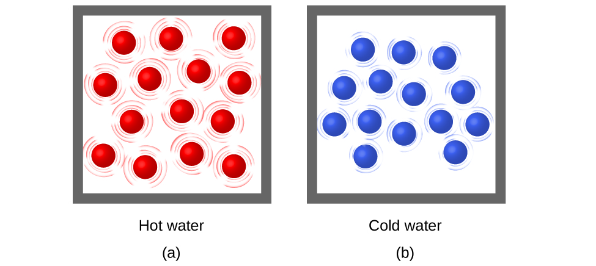
Vocabulary
Molecule – the smallest particle of a substance; it has all the properties that make up the substance.
Heat – energy that causes things to become warmer, evaporate, expand, or undergo a change; associated with the motion of molecules.
Energy – power that can be used to be active or do work.

Slide 3
Molecules Reaction to Heat

Slide 4
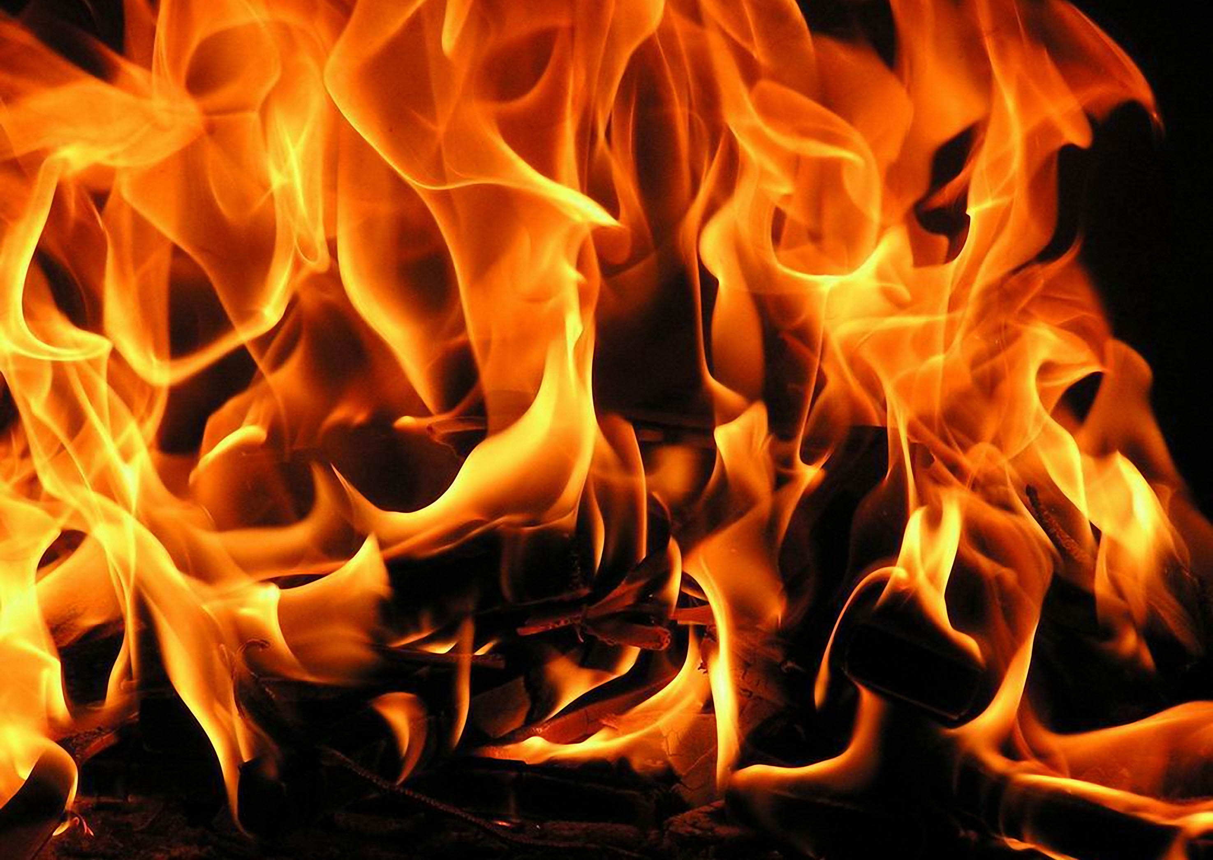
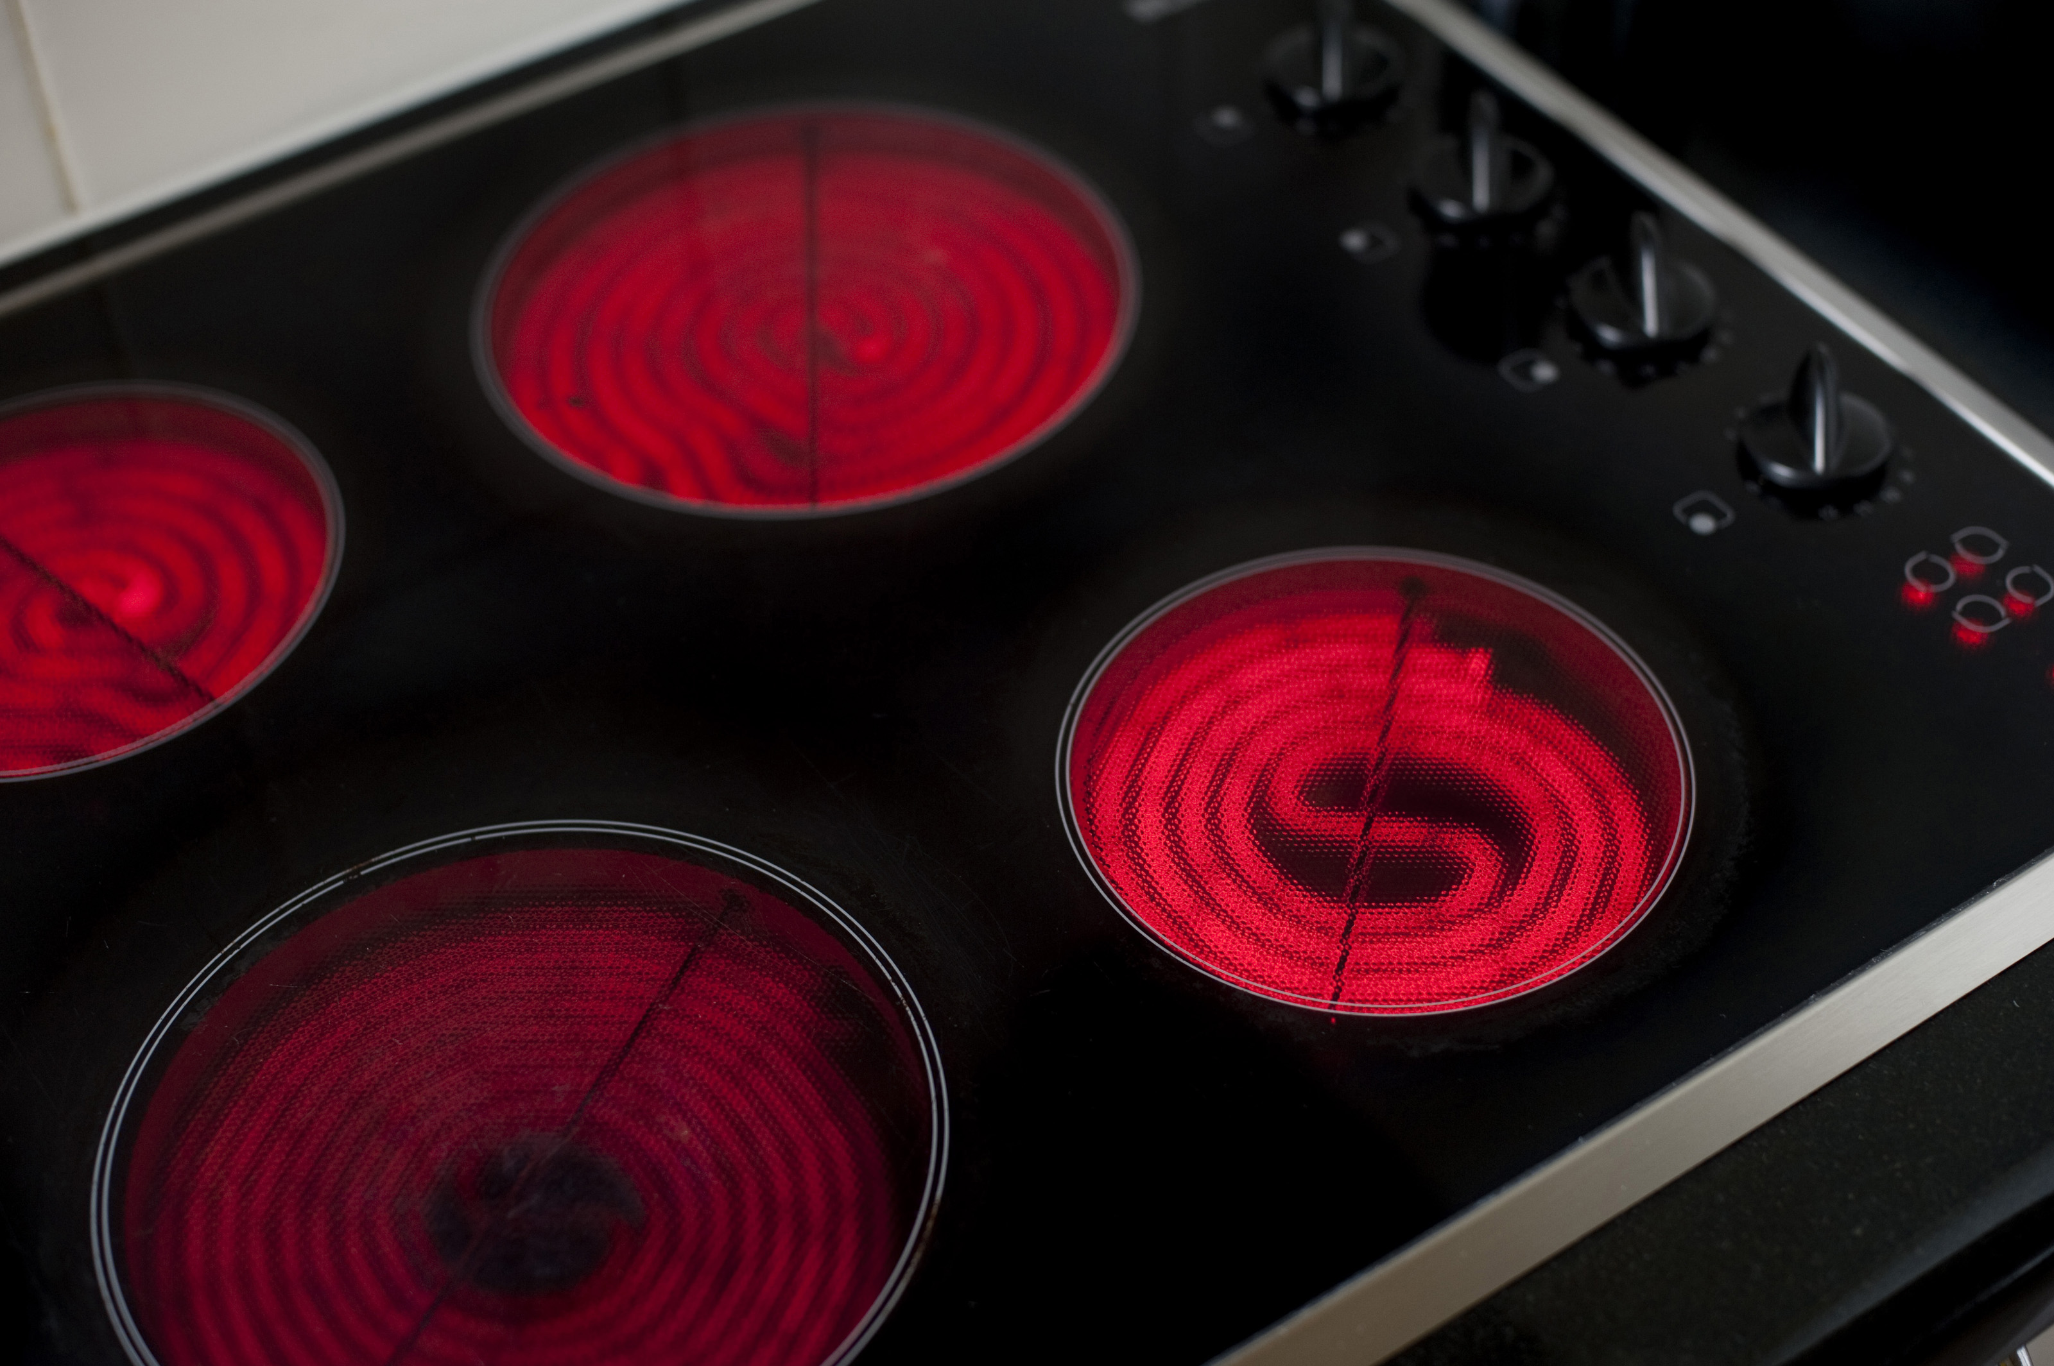
What do these have in common?
This Photo by Unknown Author is licensed under CC BY
This Photo by Unknown Author is licensed under CC BY-SA-NC

Slide 5
Experiment Time

Slide 6
Observations

Slide 7
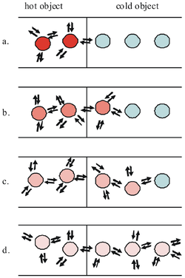
Conclusion
All matter is composed of molecules, which are always in motion. When matter is heated, molecules move faster. When matter is cooled, molecules slow down.
When a hot object is near a cool object, the heat energy transfers to the cool object.
In the experiment, hot water mixed with the tea molecules much faster, so it brewed the tea faster then the cold water.
When both containers reach room temperature, both containers look the same.

Slide 8
Discussion
Which container brewed the tea faster? Why?
Which tea bag do you think probably felt warmer? Why?
Why do people brew tea in the sun?

