Slide 1
Friction
Science Masterpiece

Slide 2
Introduction to Friction and Inclined Planes

Slide 3
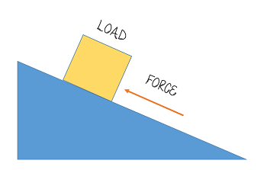
Inclined Plane
An inclined plane is a simple machine, consisting of a sloping surface, used for raising heavy objects.
The force that’s required to move an object up the inclined plane is less than the weight of the object, discounting friction.
The steeper the slope, or incline, the more the force needed to push the object up the incline, begins to equal that of the weight of the object.
GRAVITY

Slide 4
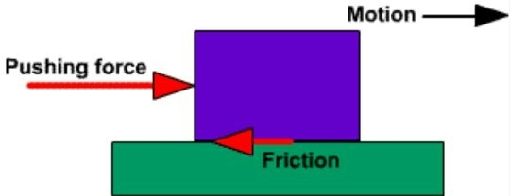
Vocabulary
Force – the push or pull that causes a change in an object’s motion.
Friction – a type of force, that causes a moving object to slow down.
Gravity – a type of force, that causes objects to fall towards Earth.
Inclined Plane – a simple machine with a flat surface and one raised end.
Angle – the space or shape formed where two lines or surfaces meet.

Slide 5
Experiment Time

Slide 6
What are your observations?

Slide 7
Conclusion
Friction affects the speed of a moving object.
Friction is the force that causes a moving object to slow down.
When friction increases, more force is needed to make an object move or go faster.
Surfaces that significantly slow movement down are called high-friction surfaces, while surfaces that allow more movement are called low-friction surfaces.
Changing the angle of an inclined plane will change the force working on an object.

Slide 8
Discussion Questions
Which material has a high-friction surface? How can you tell?
Which material has a low-friction surface? How can you tell?
What caused the block to move?
Why did the height needed for the block to move change when the plank was wrapped in different materials?
What was the highest measurement of the plank? Why?

