Slide 1
Can You Change the Direction of Light?
Science Masterpiece

Slide 3
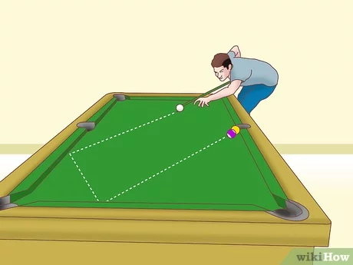
Light
Light is what makes it possible for us to see.
It reflects off objects and enters our eyes which sends signals to our brain.
Light moves in a direct line in a wave pattern.
When it hits an object in its path, it’s redirected again in a straight line. Like a pool ball on a pool table.

Slide 4
Vocabulary
Angle – the space or shape formed where two lines or surfaces meet.
Beam – a line of light coming from a source (such as the sun or headlight)
Light – a bright form of energy that travels through space.
Reflect – to throw back light, sound, or heat that hits a surface.

Slide 5
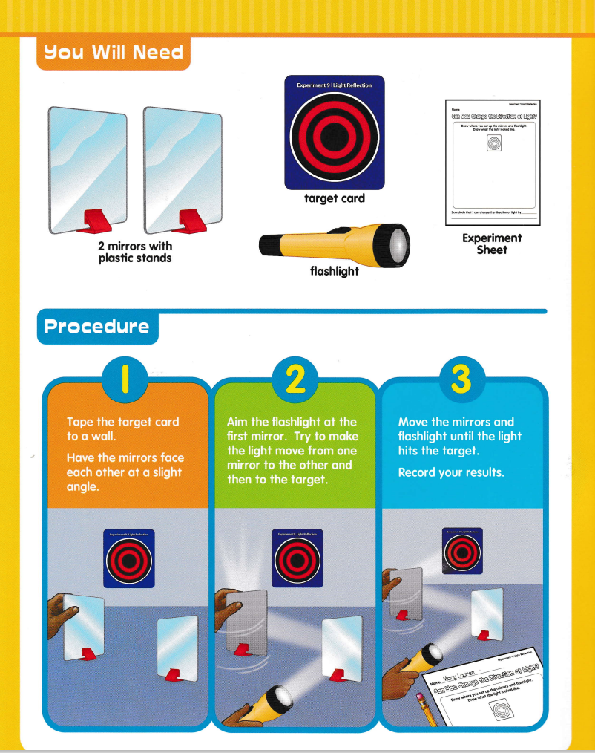
Experiment Time

Slide 6
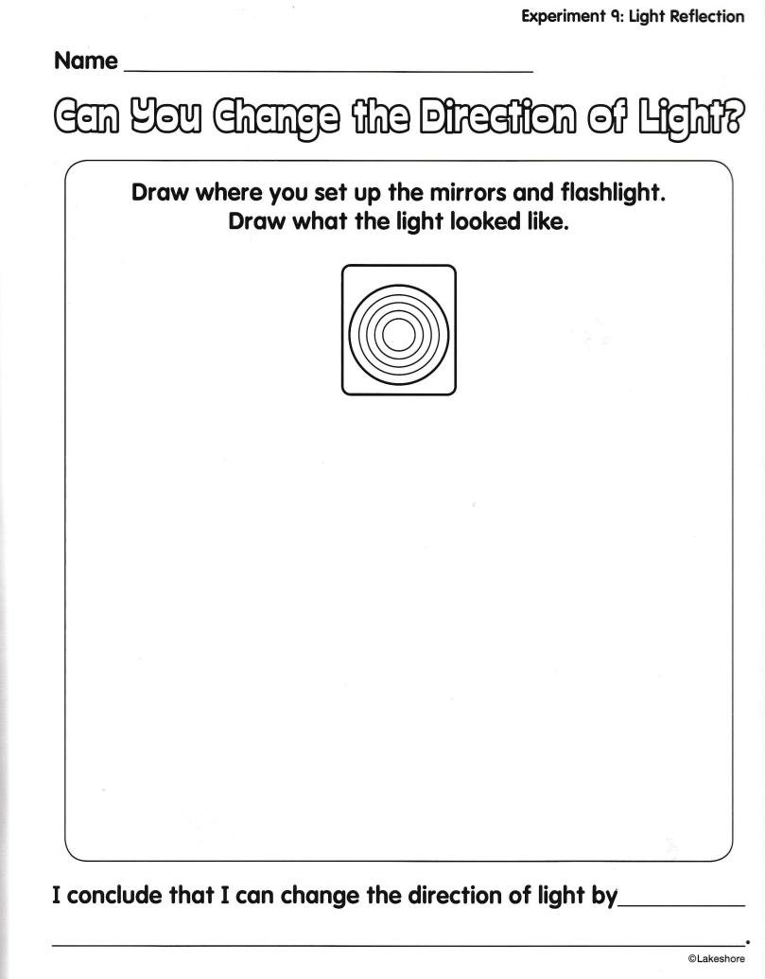

Slide 7
Questions
What does the light do? In What direction is it traveling?
What happens if you move one mirror? What happens if you move both?
What happens if you aim the flashlight more to one side? What if you aim it more up or down?
How you make the light hit both mirrors and the target?

Slide 8
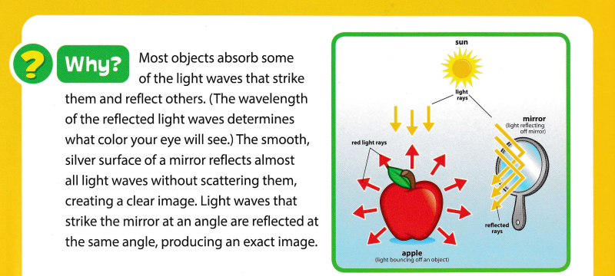
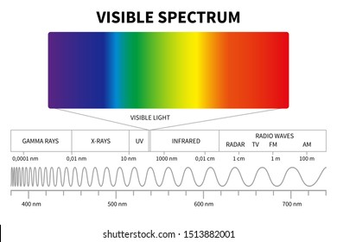
Conclusion

