Slide 1
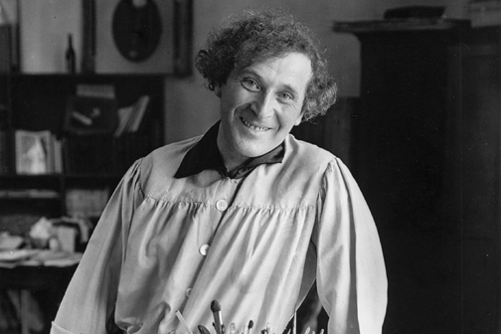
Mark Chagall
July 7, 1887 – March 28, 1985

Slide 3
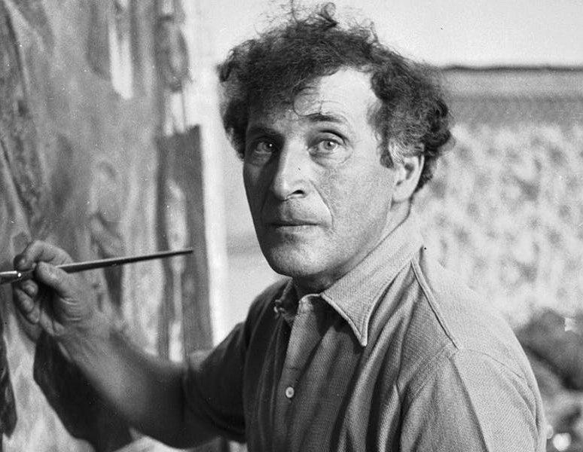
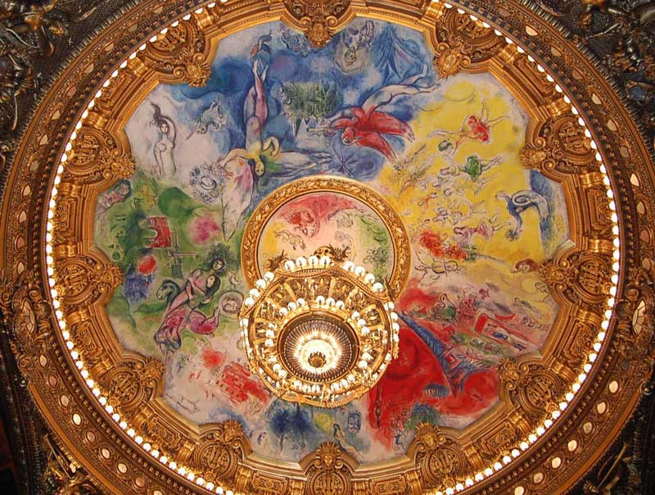
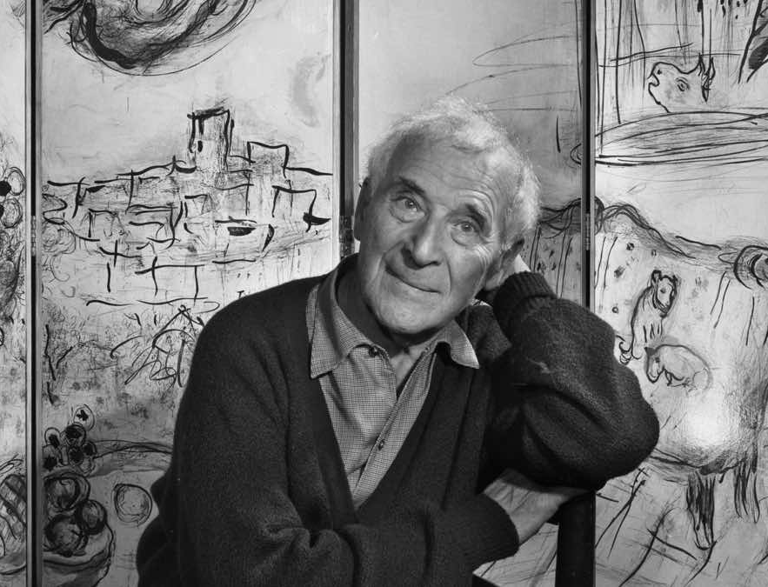
Life of Marc Chagall
Born July 7, 1887 in Russia
His family, which included eight other children, was devoutly Jewish
Highly successful Surrealism Artist
Chagall avoided the spotlight and was disinterested in fame. He sometimes denied being the famous painter and when asked if he was THE Chagall, the artist would mischievously point to someone else and say, “Maybe that’s him.”
Chagall painted the ceiling of the Opéra Garnier in Paris. The painting is a tribute to fourteen significant opera composers and their work, and he completed it at seventy-seven years of age! Additionally, despite the mammoth task, Chagall refused to be paid for his work.

Slide 4
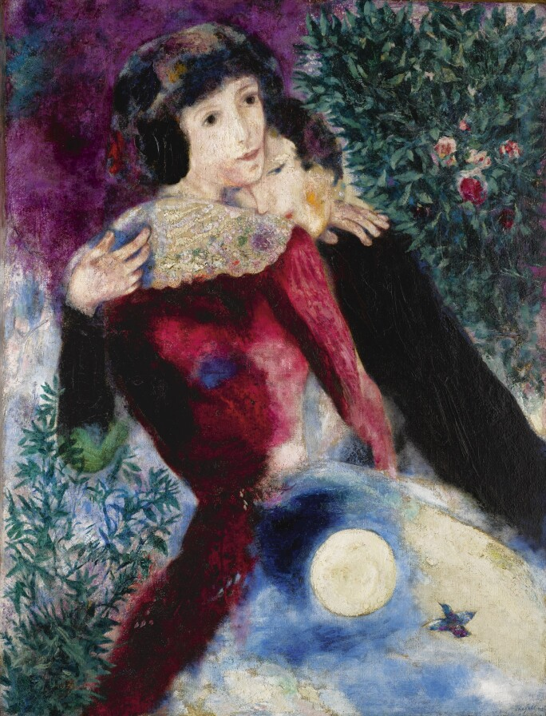
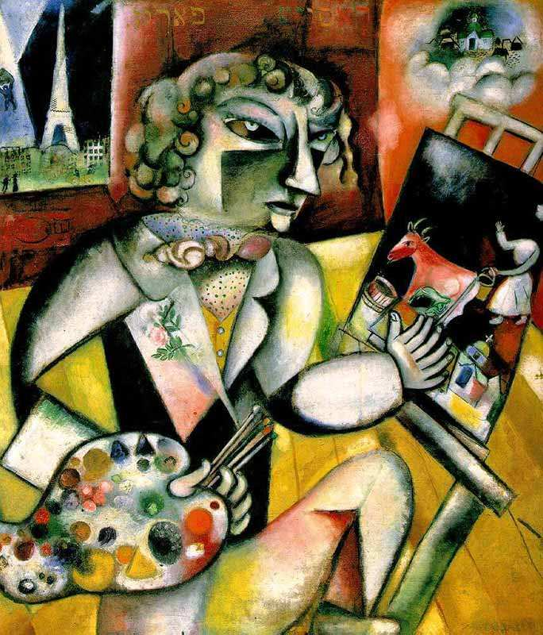
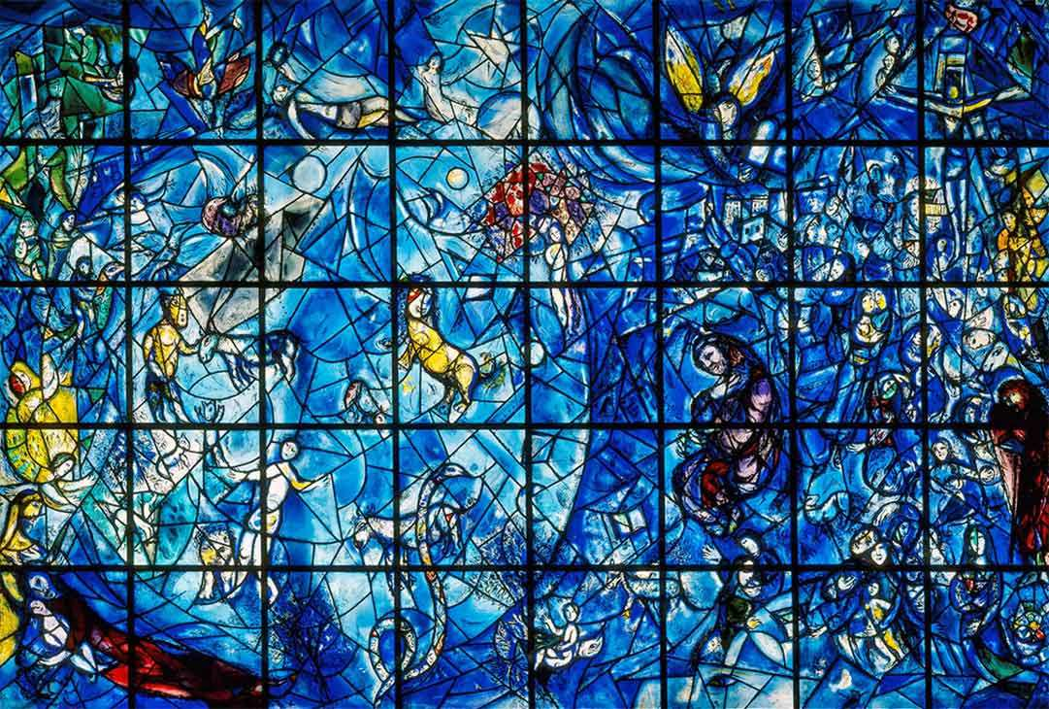
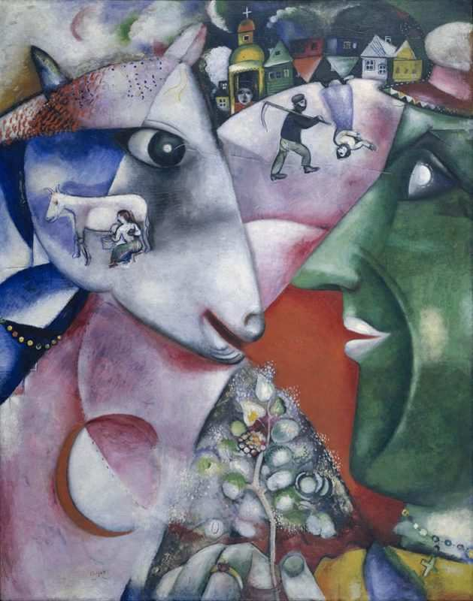
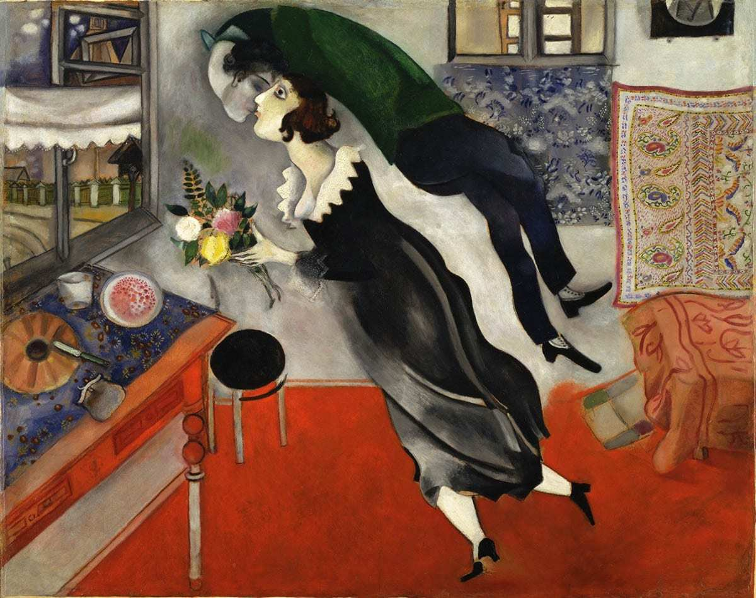
Art Work
Peace Window
United Nations Building
New York, 1964
I and the Village (1911)
In 2017, Chagall’s work, Les Amoureux (The Lovers), sold for a staggering $28.5 million at Sotheby’s New York.
Sotheby’s claimed the painting encapsulated Chagall’s two greatest passions; Bella and Paris.
Self Portrait with Seven Fingers (1912-13)
Birthday (1915)

Slide 5
Discussion…
What’s going on in this artwork?
What was your first reaction to this artwork? Why do you think you had the reaction?
Does your opinion about the artwork change the longer you look at it? Why?
Describe the lines in this artwork
What verbs would you use to describe this artwork?

Slide 6
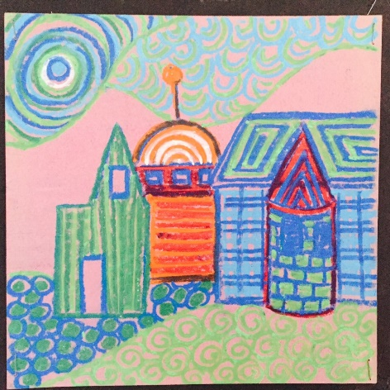
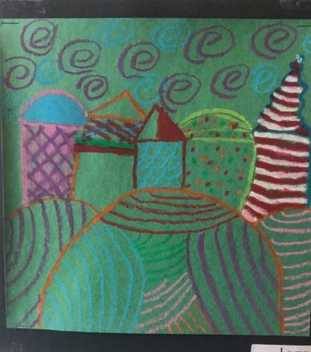
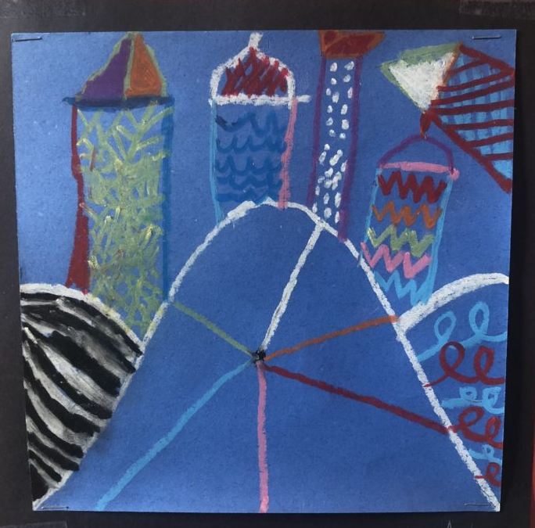
Today’s Art Lesson
Pattern Villages
Use as many patterns and colors as you can
Buildings and objects can be floating
Recall Chagall’s paintings and how there were no rules to the objects in his work

