Slide 1
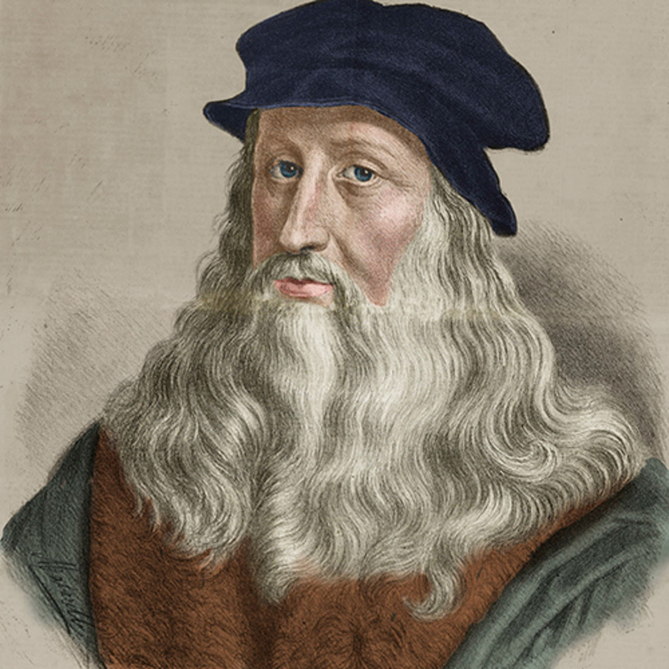
Leonardo da Vinci
April 15, 1452 – May 2, 1519

Slide 3
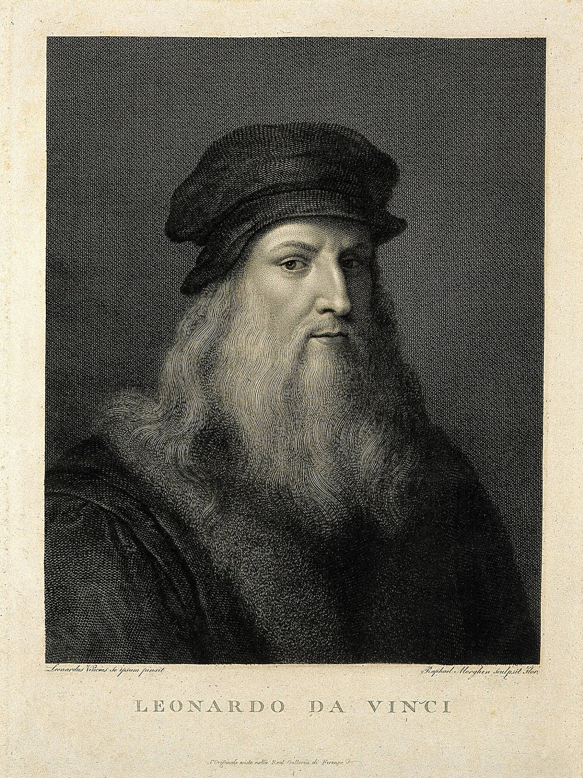
Life of Leonardo da Vinci
Born in April 1452 in Vinci, Republic of Florence
Leonardo da Vinci is one of the greatest painters of all time, and one, if not the greatest figure of the Renaissance period
He was a thinker that was way ahead of his time. Driven by the strong urge to quench his curiosity as well as to gain as much knowledge by study and practice. Leonardo Da Vinci became a master in various occupations - as an anatomist, architect, engineer, scientist, inventor, geologist, cartographer, sculptor, and painter
Da Vinci was born a lefty and was known as “mancino” which is Italian slang for left-handed person. Experts look for sign of left handedness to authenticate Da Vinci’s work.
Leonardo has been described as the very picture of a Renaissance Man because he had many talents and areas of knowledge. He was a man of insatiable curiosity which drove him to not only study his many interests but also prove or disprove his learnings by doing and experimentation. He was interested in how things work and would persistently study a single object for days, weeks, even months

Slide 4
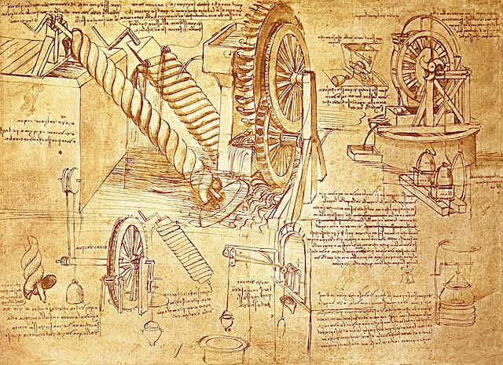
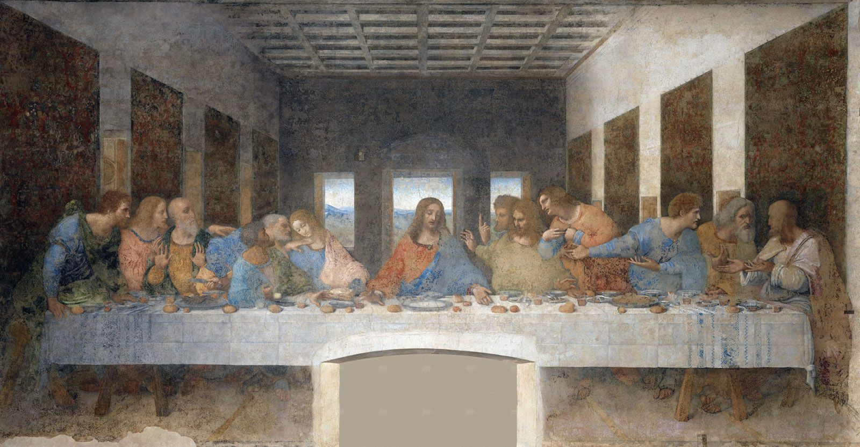
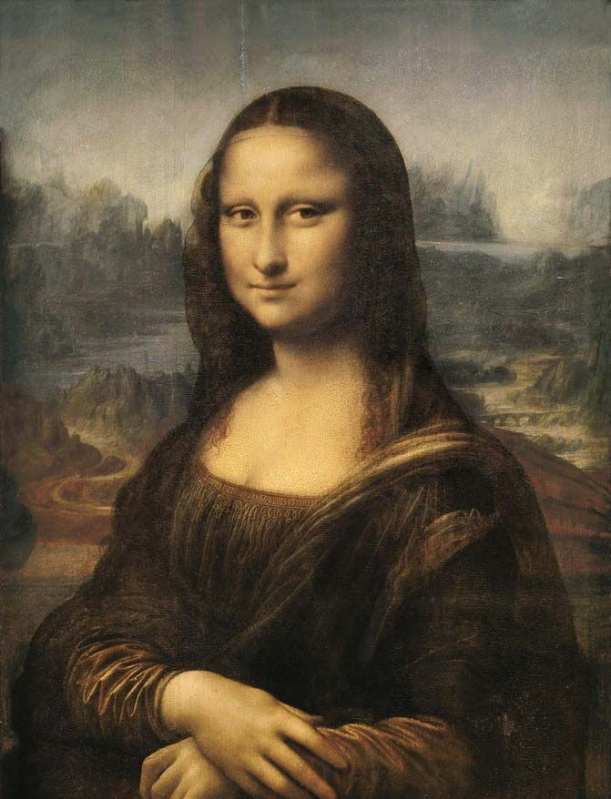
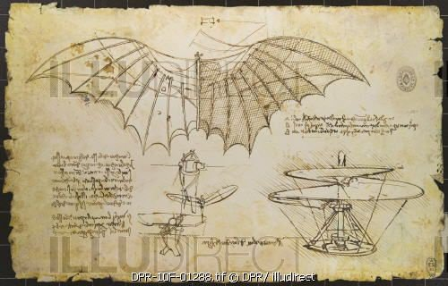
Art Work
Mona Lisa
Sketches of various Inventions
The Last Supper

Slide 5
Discussion…
What’s going on in this artwork?
What was your first reaction to this artwork? Why do you think you had that reaction?
Does your opinion about the artwork change the longer you look at it? Why?
Describe the lines in this artwork
What verbs would you use to describe this artwork?

