Slide 1
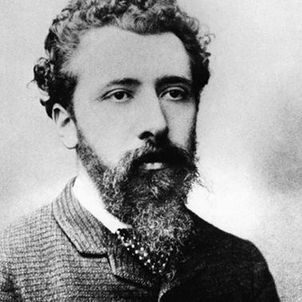
Georges Pierre Seurat December 2, 1859 – March 29, 1891

Slide 3
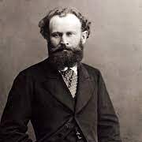
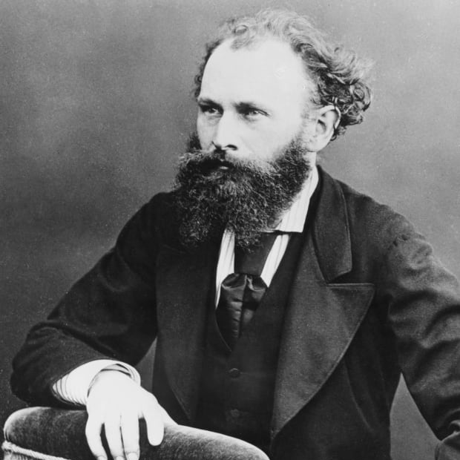
Life of Georges Seurat
French post-Impressionist artist using chromoluminarism & pointillism technique
Born to a wealthy family & he was able to attended a prestigious art school in his town
He was drafted to military service in 1879 and spent a year doing military work
After his military service he spent time perfecting his painting technique
Died at a young age of 31 leaving his legacy of 7 famous works of art, hundreds of drawings/sketches & 40 smaller scale paintings
Cause of death was unknown

Slide 4
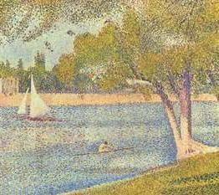
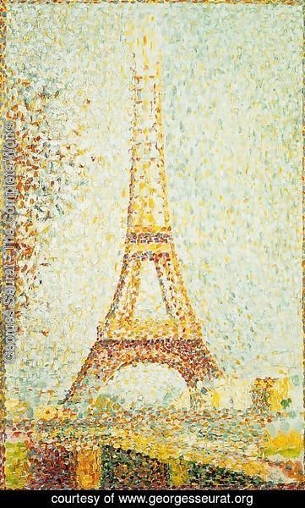
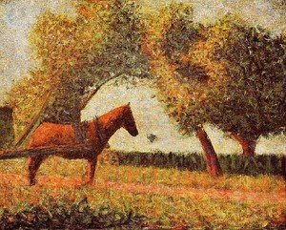
ART WORK
The river Seine at La Grande-Jatte
The Horse
The Eiffel Tower 1889

Slide 5
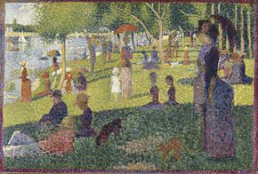
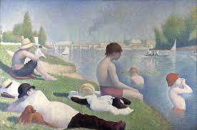
Sunday Afternoon on the Island of la Grande Jatte (1886)
Most well-known work of art:
Sunday Afternoon on the Island of La Grande Jatte
Painting uses the technique pointillism
Pointillism is tiny detached brush strokes in different colors that come together to create an image
From sketching to finished painting it took Seurat 3 years to complete
This painting was part of a pair, but the 1st painting was rejected
Painting depicts upper-class people across the river
Bathers at Asnières which is the pair to the Sunday Afternoon. It was initially rejected
Painting depicts common people bathing in the suburbs

Slide 6
Discussion…
What’s going on in this artwork?
What was your first reaction to this artwork? Why do you think you had the reaction?
Does your opinion about the artwork change the longer you look at it? Why?
Describe the lines in this artwork
What verbs would you use to describe this artwork?

Slide 7
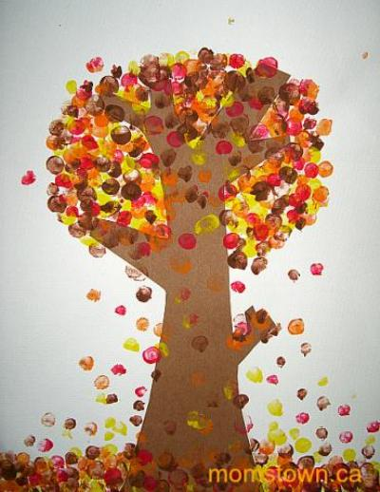
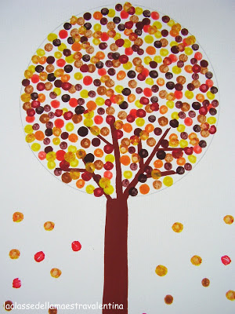
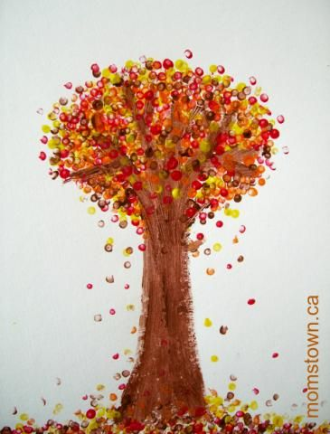
Today’s art project
Fall Fingerprint Tree

