Slide 1
Piet Mondrian March 7, 1872 – February 1, 1944

Slide 3
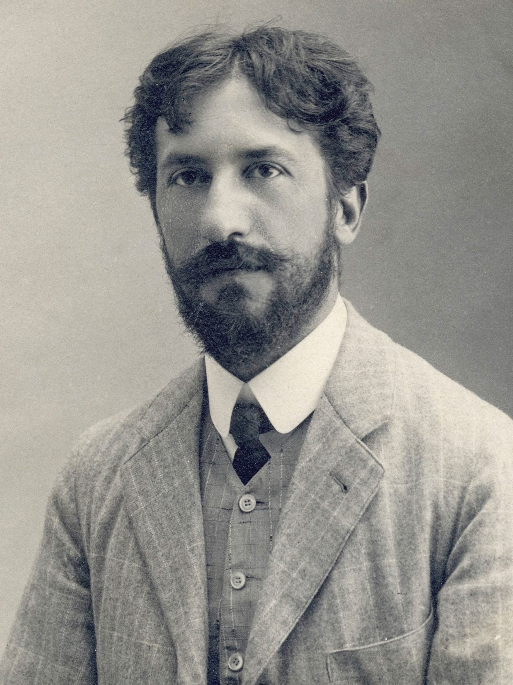
Life of Piet Mondrian
Piet was born in the Netherlands
His father was a qualified art instructor & his Uncle was an artist
Piet worked as a school teacher before he became an artist full time
Piet liked to dance! Not slow dancing -- high energy, fast dancing
Piet passed away from Pneumonia in 1944

Slide 4
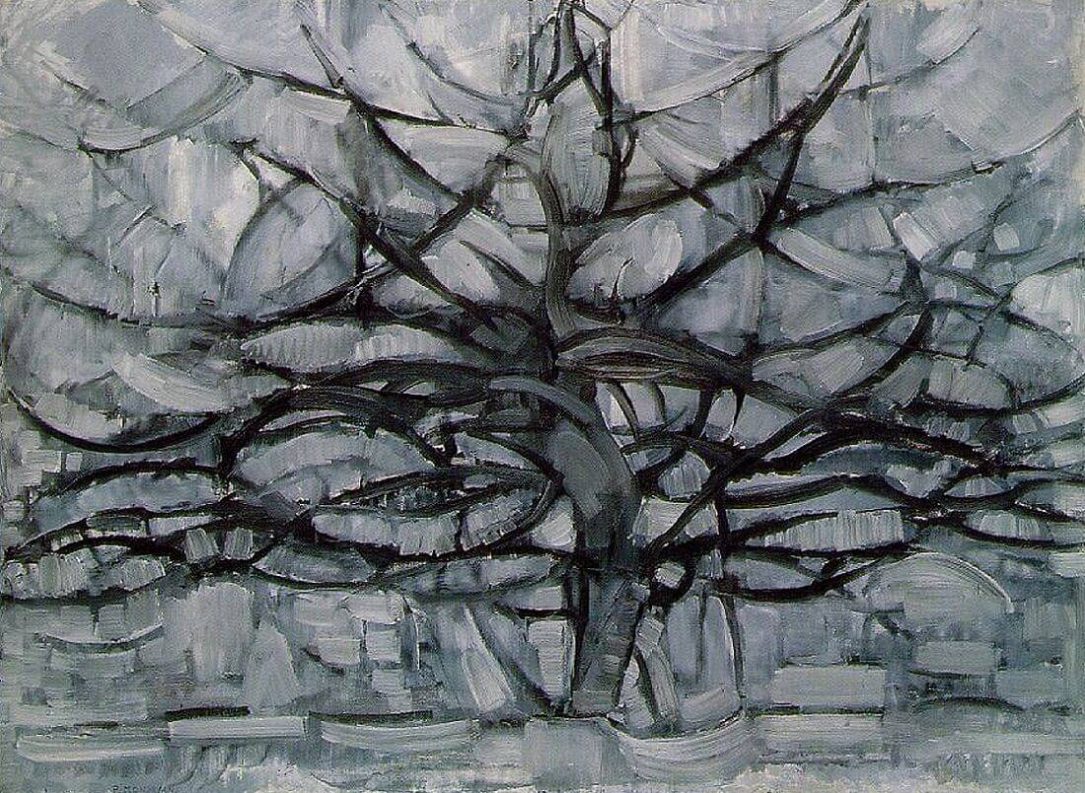
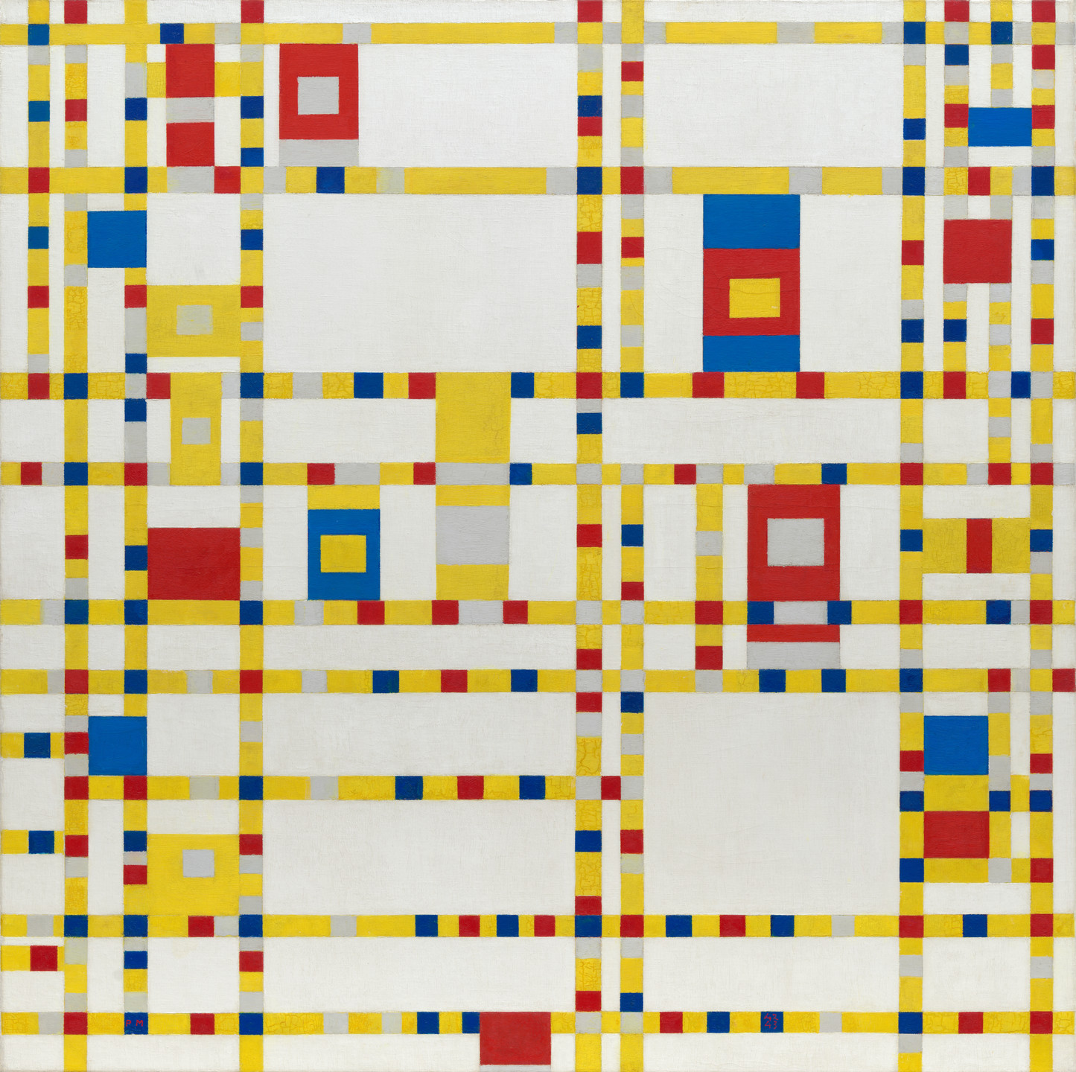
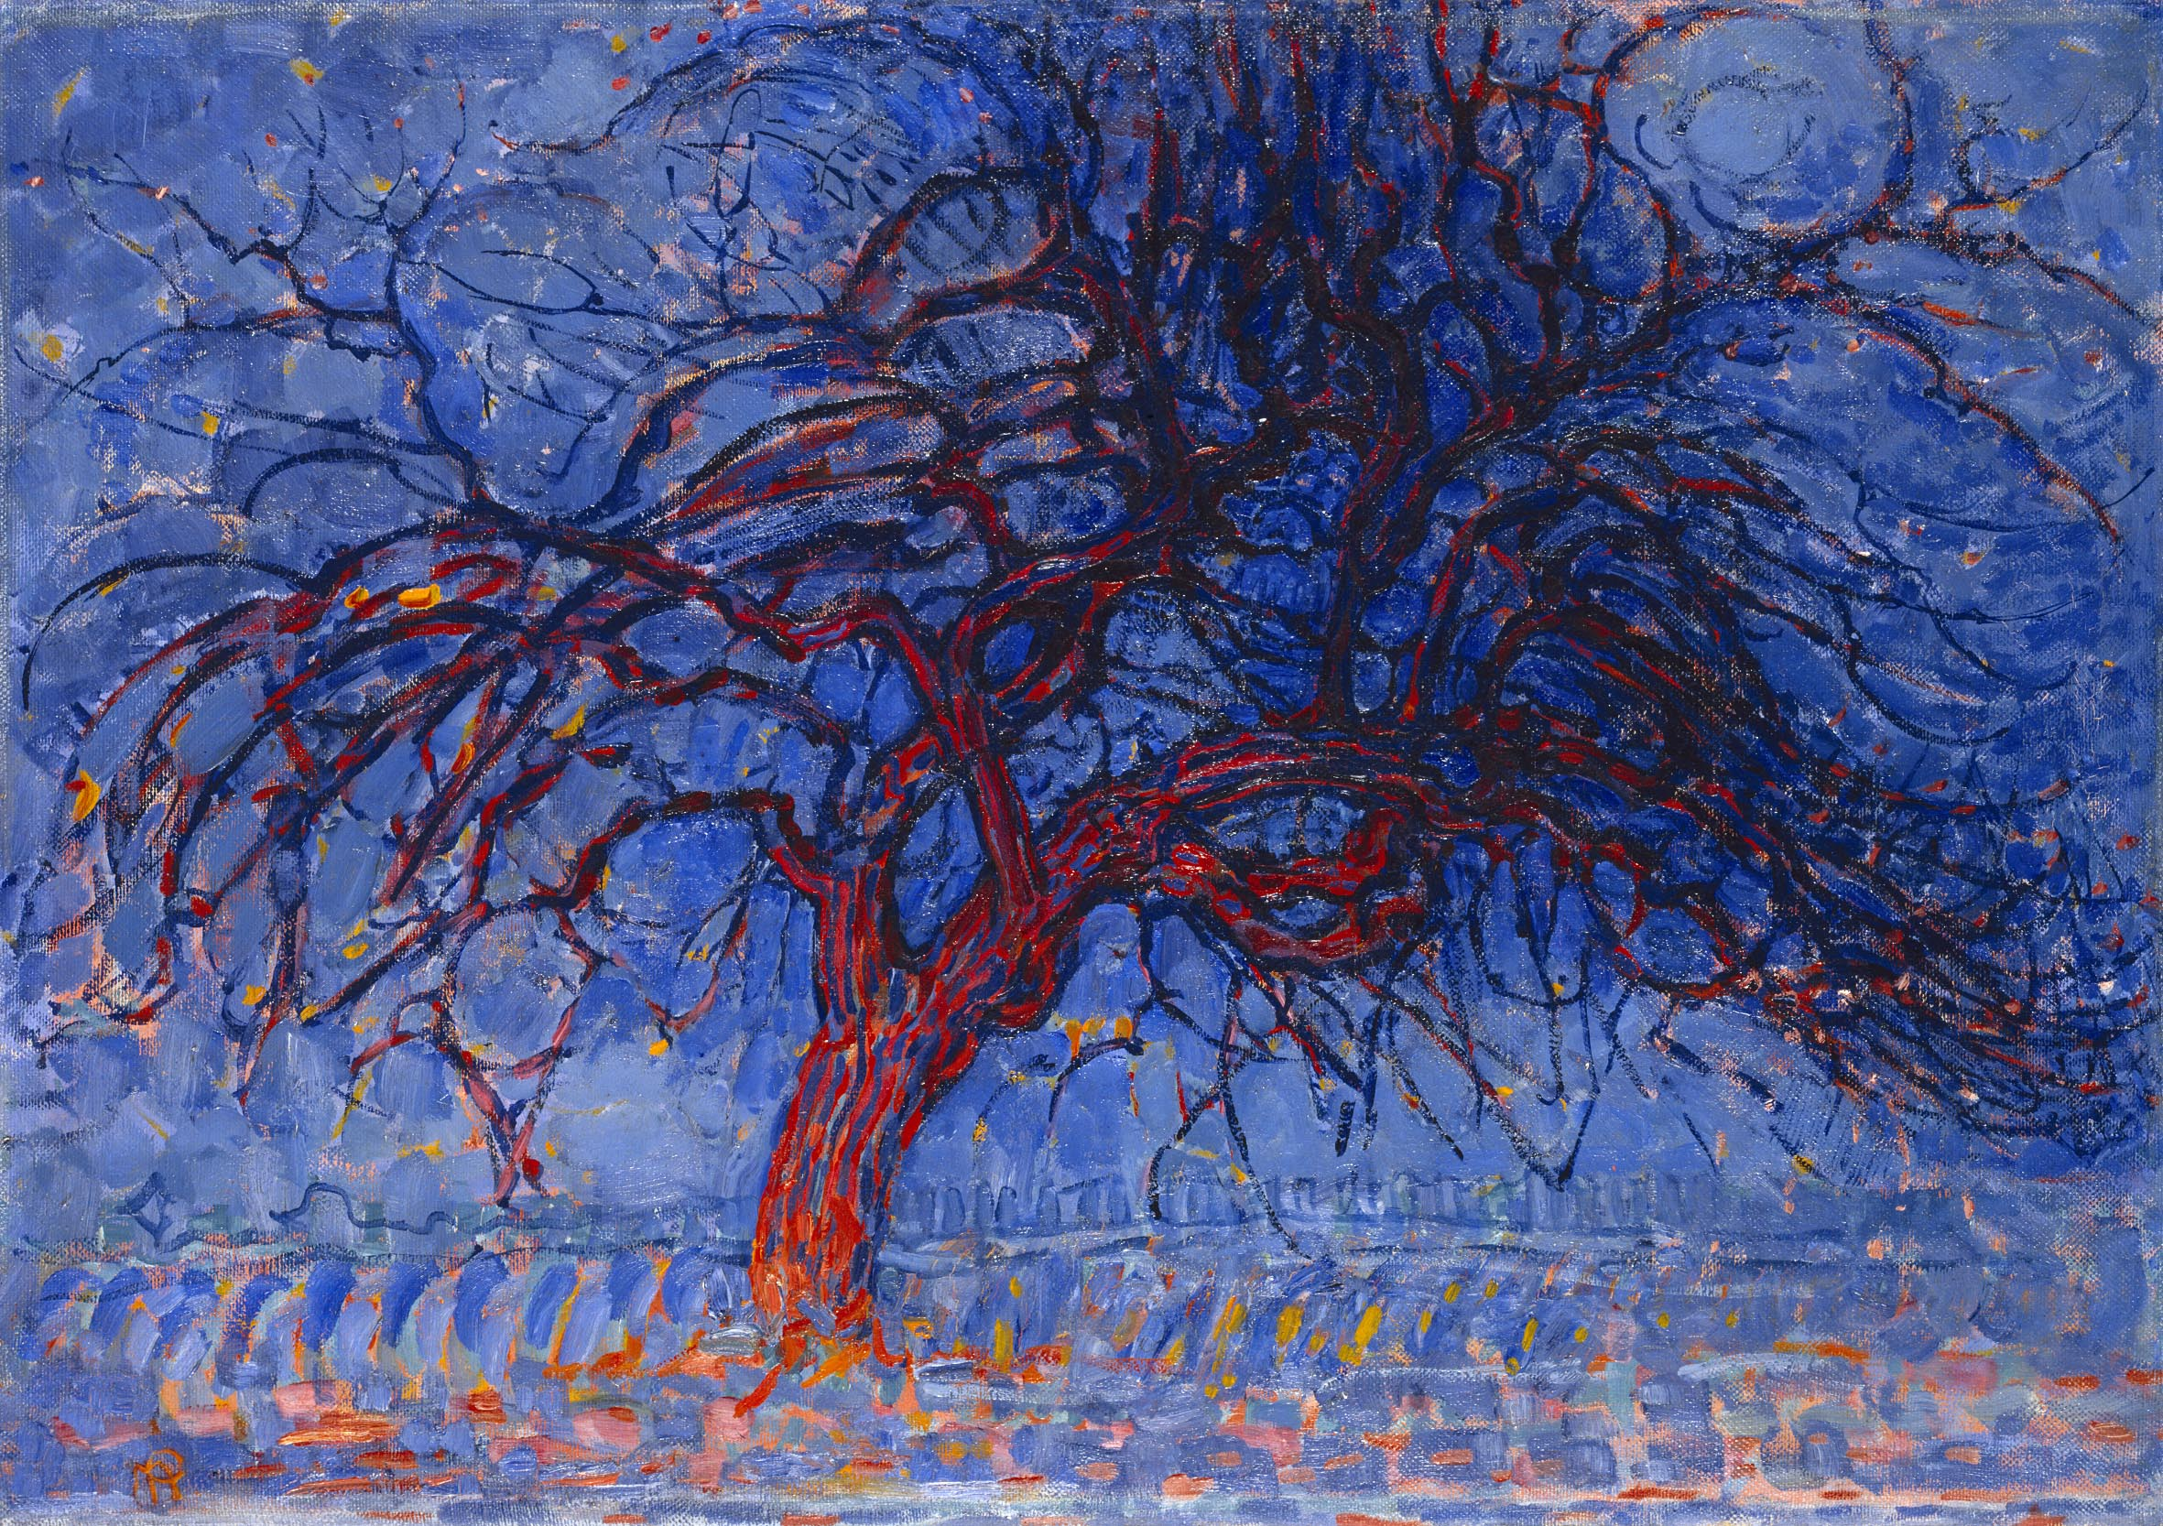
Art Work
The Gray Tree (1912)
Broadway Boogie Woogie (1943) –
Title was inspired by a current popular song & his love for dancing
The Red Tree (1910)
Composition with Large Red Plane, Yellow, Black, Gray and Blue (1921)

Slide 5
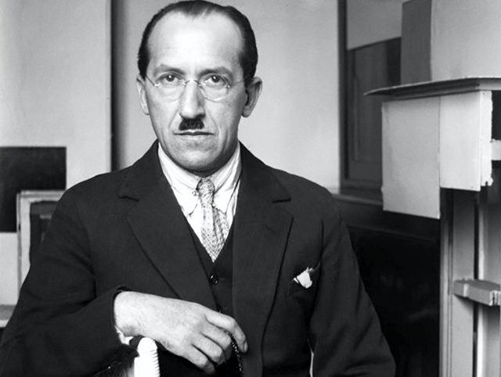
Piet was a Dutch artist known for abstract art
Abstract art is a style that does not use people, objects or landscapes. It uses color, shapes & texture instead.
Piet did not use a ruler for his straight lines, he spent lots of time making them precise
Discussion…
What was your first reaction to this artwork? Why do you think you had that reaction?
Describe the lines in this artwork
What colors do you see consistently in this artwork?

Slide 6
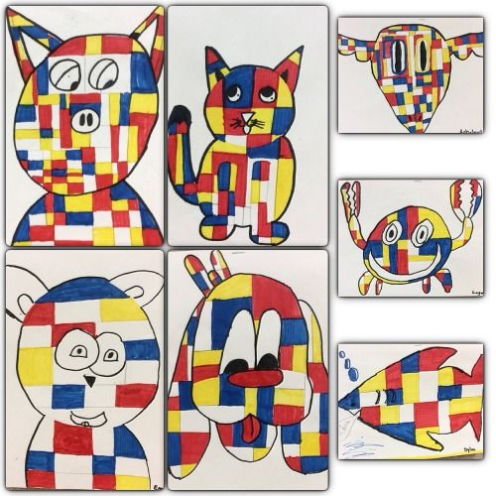
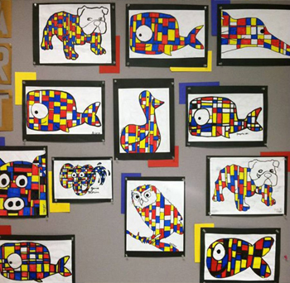
Today’s Art Lesson
Puppy Squares Coloring

