Slide 1
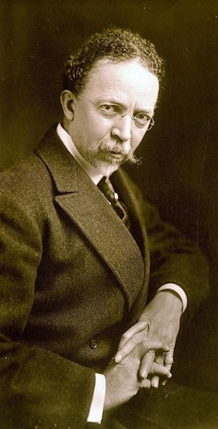
Henry Ossawa Tanner
June 21, 1959 – May 25, 1937

Slide 2
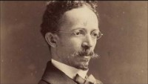

Slide 3
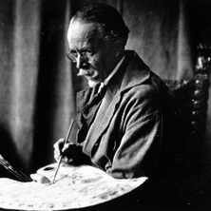
Henry Ossawa Tanner’s Life
Born in Pittsburgh, Pennsylvania
At the age of 21, Tanner enrolled at the Pennsylvania Academy of the Fine Arts in Philadelphia
His father was a minister in the African Methodist Church which influenced his paintings of religious subjects
In late 1891, Tanner left America for France and except for occasional brief returns home; he would spend the rest of his life there
Tanner is often regarded as a realist painter. He focused on accurate depictions of subjects, as well as lighting to show a lot of emotion and mood
First African American artist to become internationally famous. That means people in many countries knew him, what an incredible success for him!!

Slide 4
Art Work
The Banjo Lesson (1893)
Depicts an elderly black man teaching what is assumed to be his grandson how to play the banjo
Tanner shows the people as they really are, not as cartoon characters, which is how most artist drew African Americans at this time
The Thankful Poor (1894)

Slide 5
Art Work
The Annunciation (1898)
Spinning by Firelight (1894)
Daniel in the Lions Den (1907)
The Three Marys (1910)

Slide 6
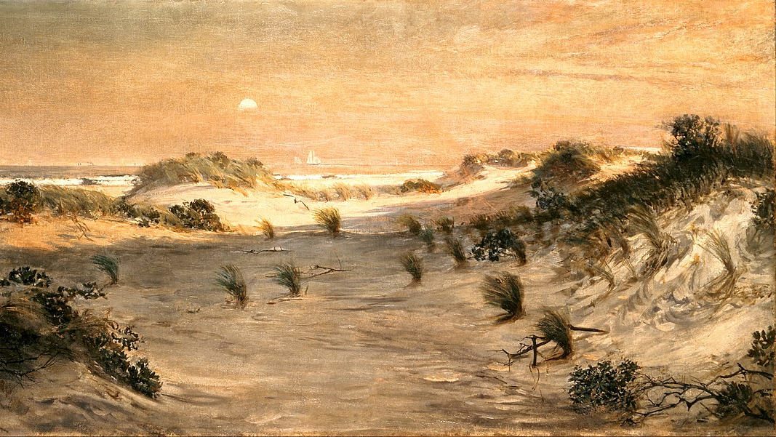
Sand Dunes at Sunset, Atlantic City (1885) is the first painting by an African American artist to enter the permanent collection of the White House.

Slide 7
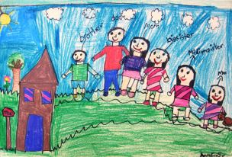
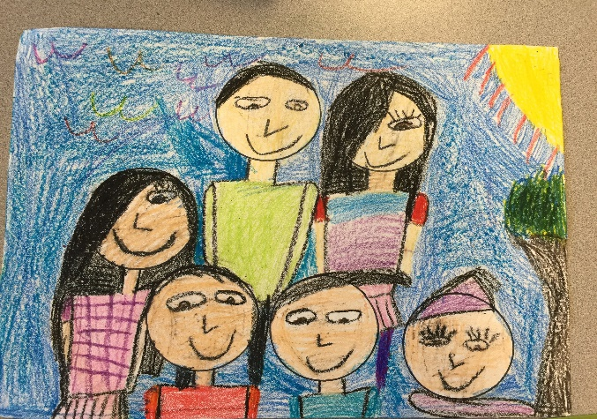
Today’s Art Lesson
Family Portraits!!

