Slide 1
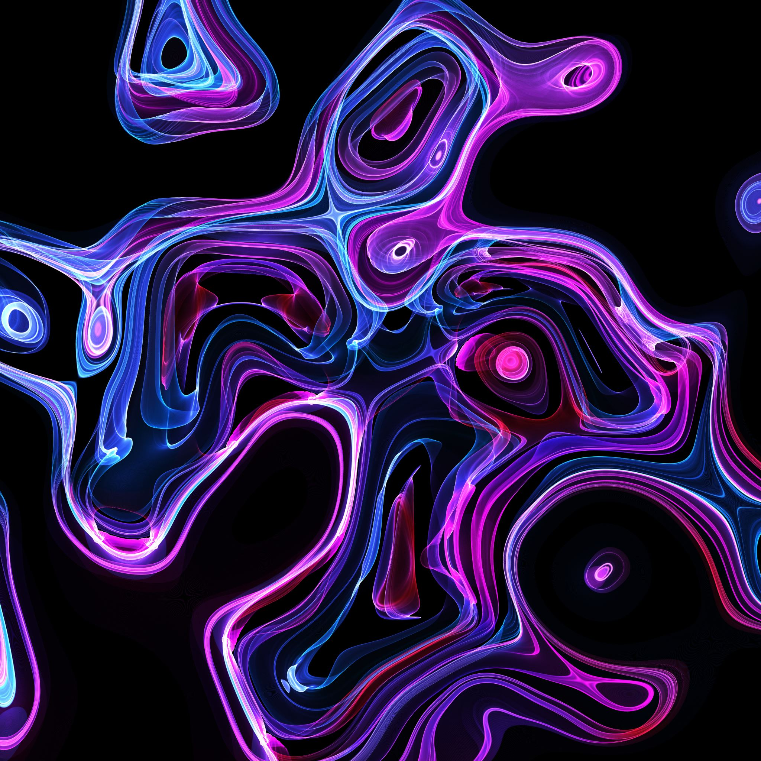
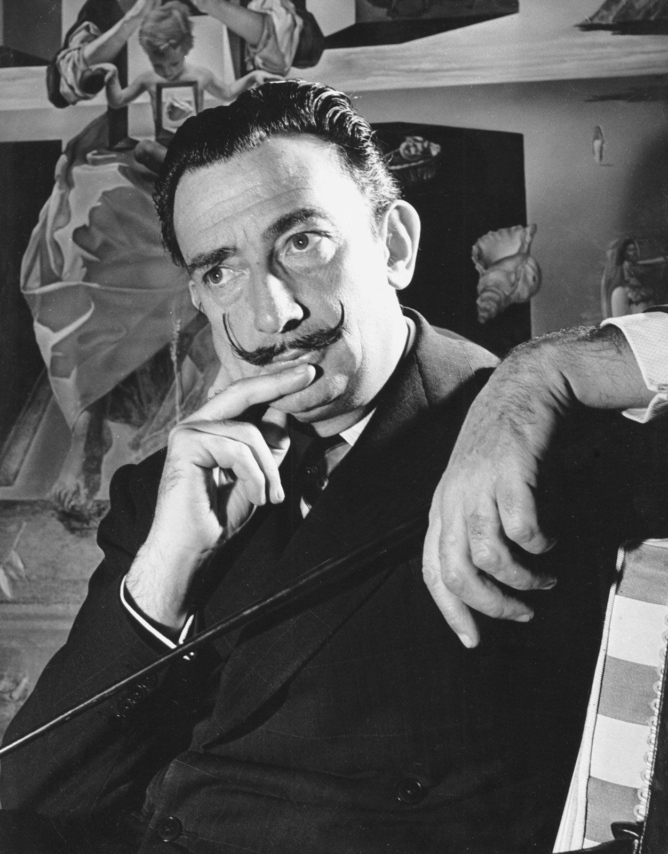
Salvador Dali
May 11, 1904 - January 23, 1989

Slide 3
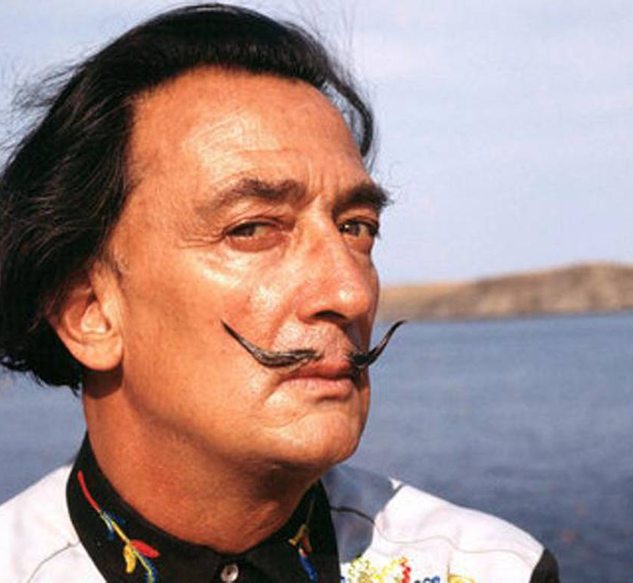
Salvador Dali’s Life
Born in Figueres, Catalonia Spain
Began drawing school in 1916 at age 12
In 1922 Dali moved to Madrid for college, he became known for being very eccentric
Married wife, Gala, in 1934
Became famous Surrealism artist
Made many famous friends like Elvis Presley, John Lennon, David Bowie, Pablo Picasso, Sigmund Freud & Alice Cooper
Made a short film titled “Destino” with Walt Disney in 1946, it was not completed until 2003…57 years later
Dali died in January 23, 1989 listening to his favorite record, Tristan & Isolde

Slide 4
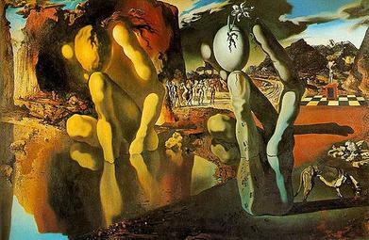
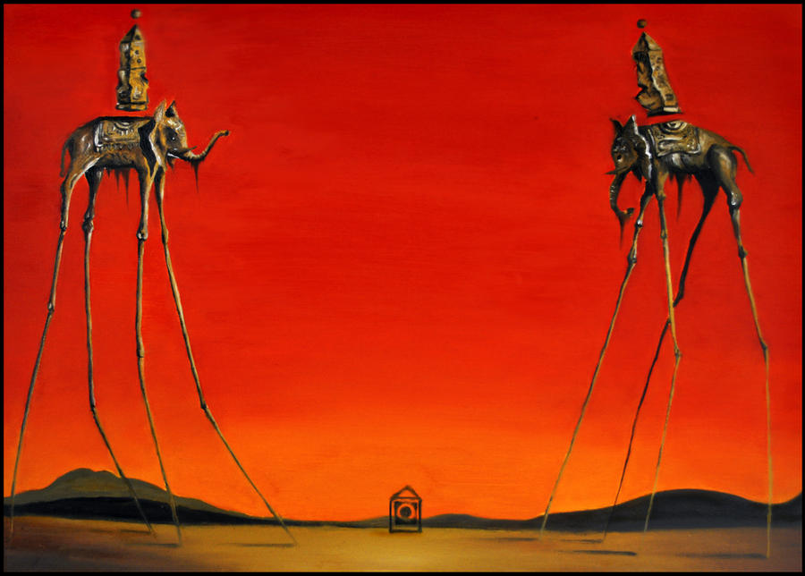
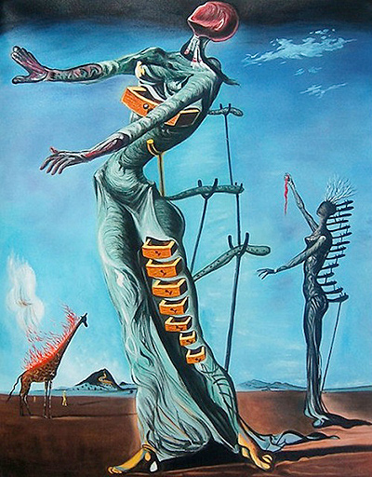
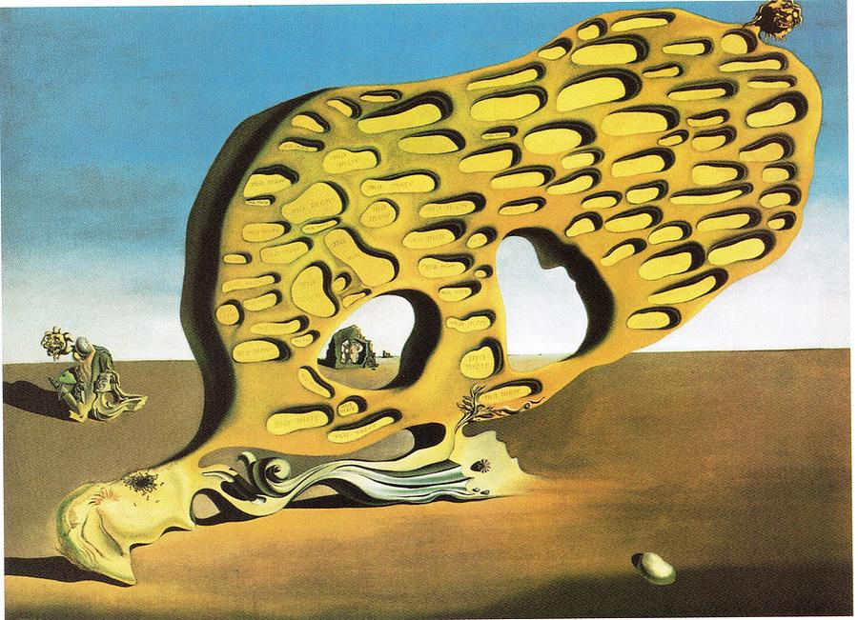
Metamorphosis of Narcissus
The Elephants
ART
WORK
What do you notice about them all?
The Burning Giraffe
The Enigma of Desire

Slide 5
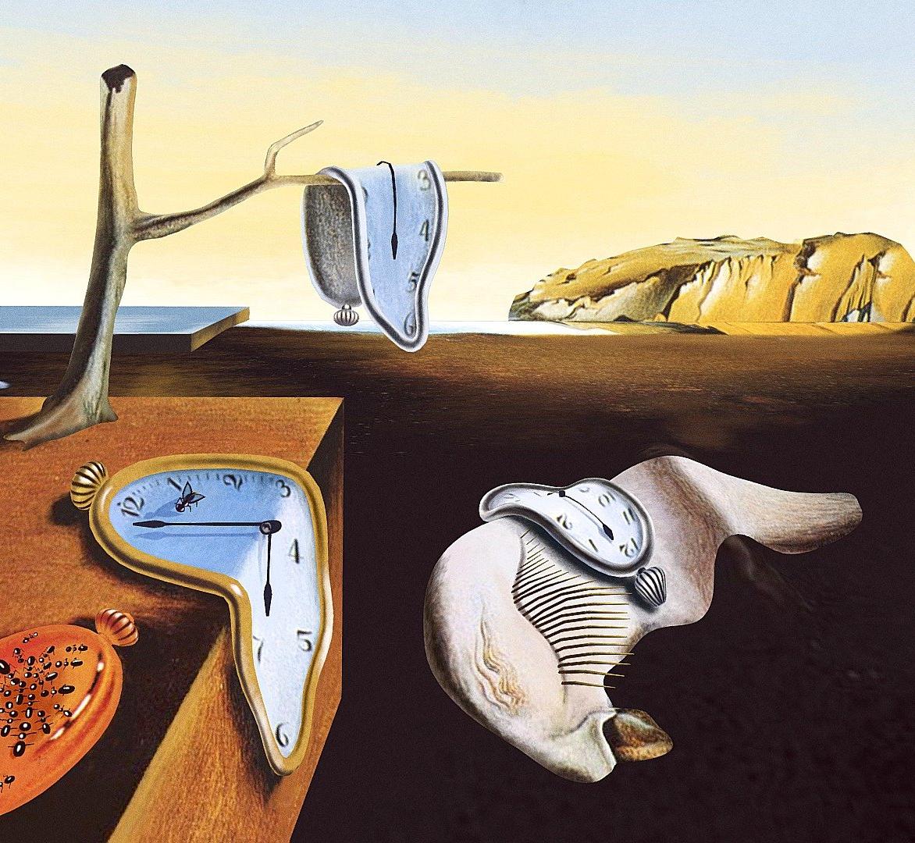
The Persistence of Memory
This painting was Dali’s “big break” and is know as one of the most famous surrealism paintings
Surrealism is art that adds an artistic twist to everyday objects

Slide 6
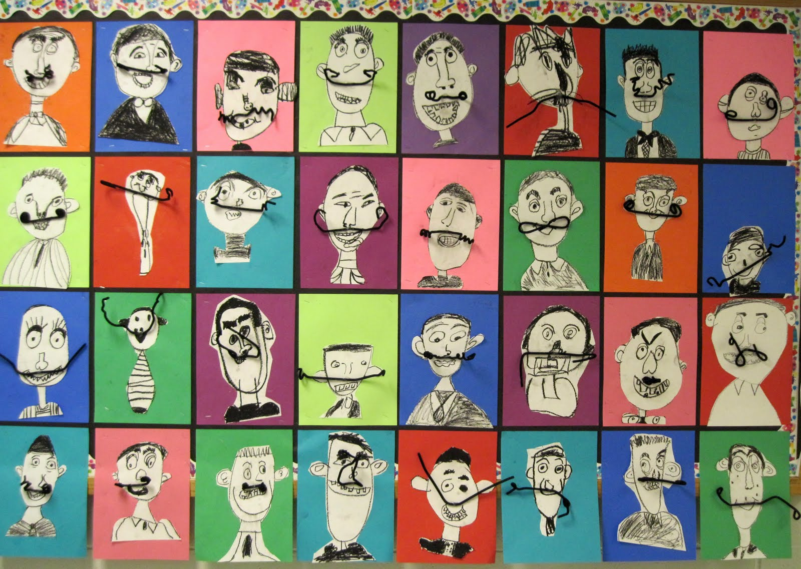
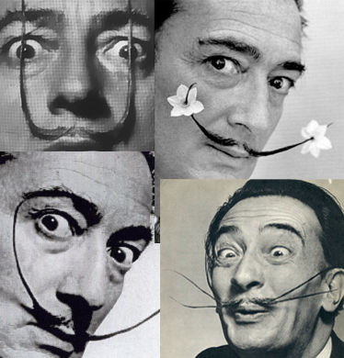
Today’s Art Lesson
Self-Portrait with a quirky twist!

