Slide 1
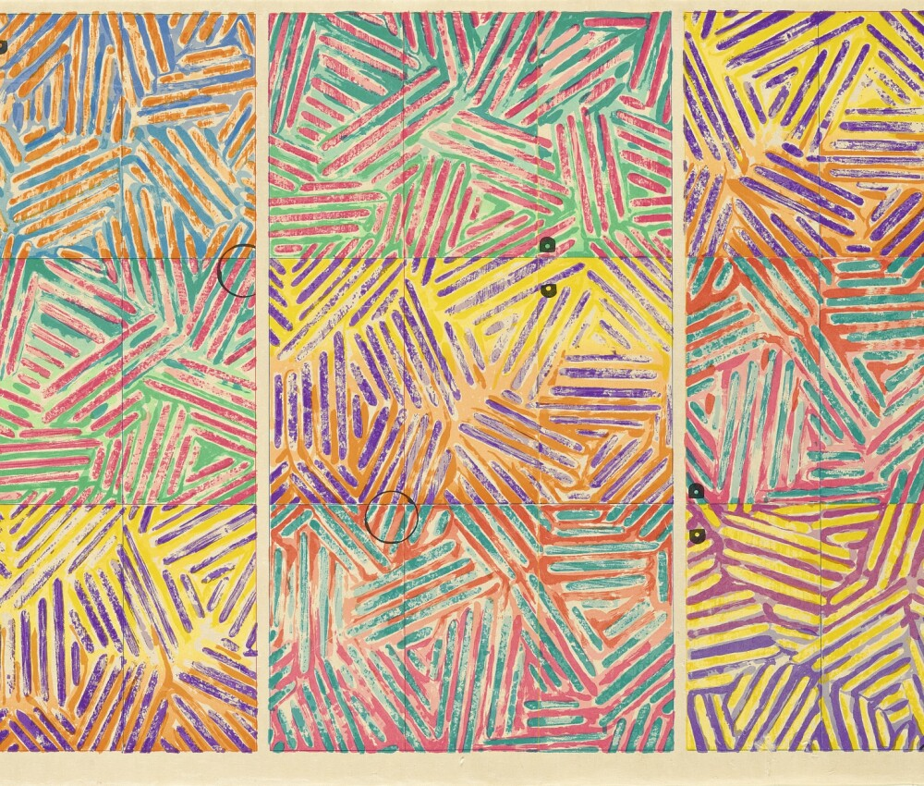
Jasper Johns
Art Masterpiece

Slide 3
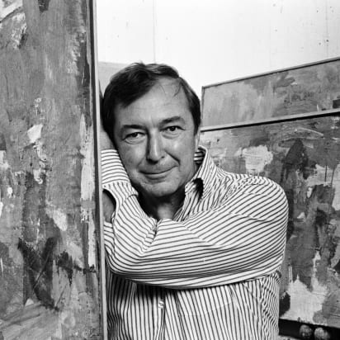
Jasper Johns
Born May 15, 1930, in Augusta, Georgia
American Painter and Print Maker
He used Stencils and layers of paint to create his images.
His work was considered Abstract Expressionism and Pop Art
He loved to take everyday things to create interesting artwork.

Slide 4
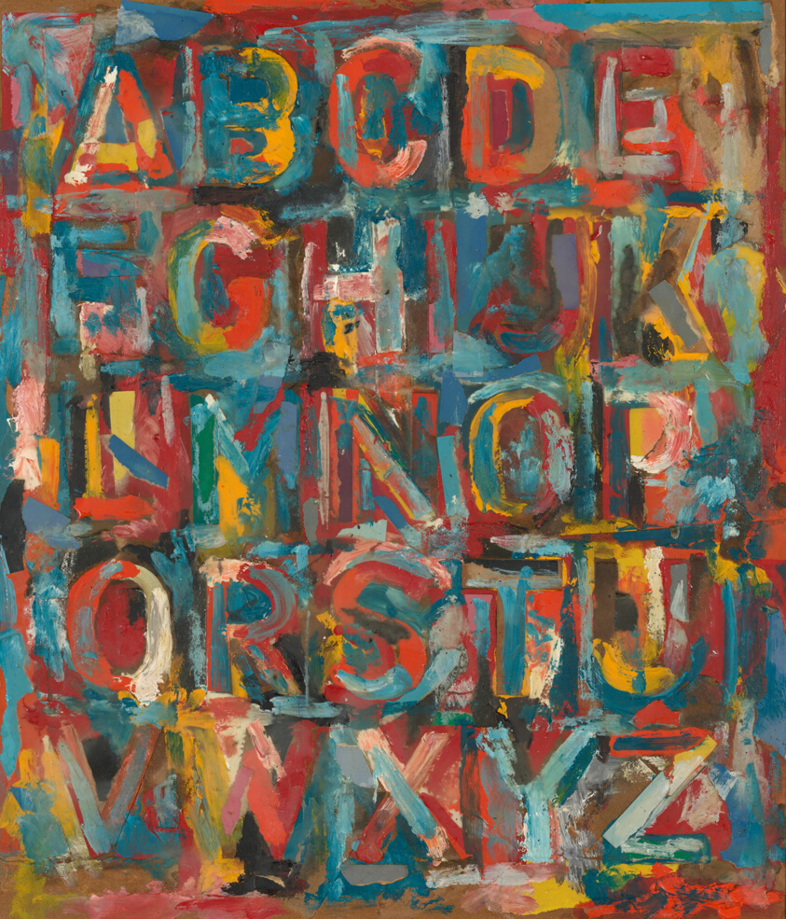
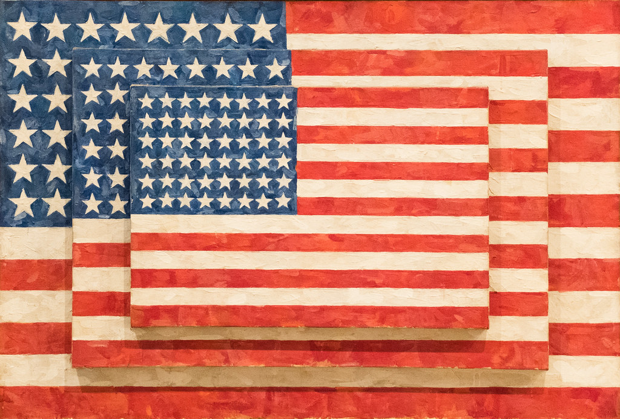
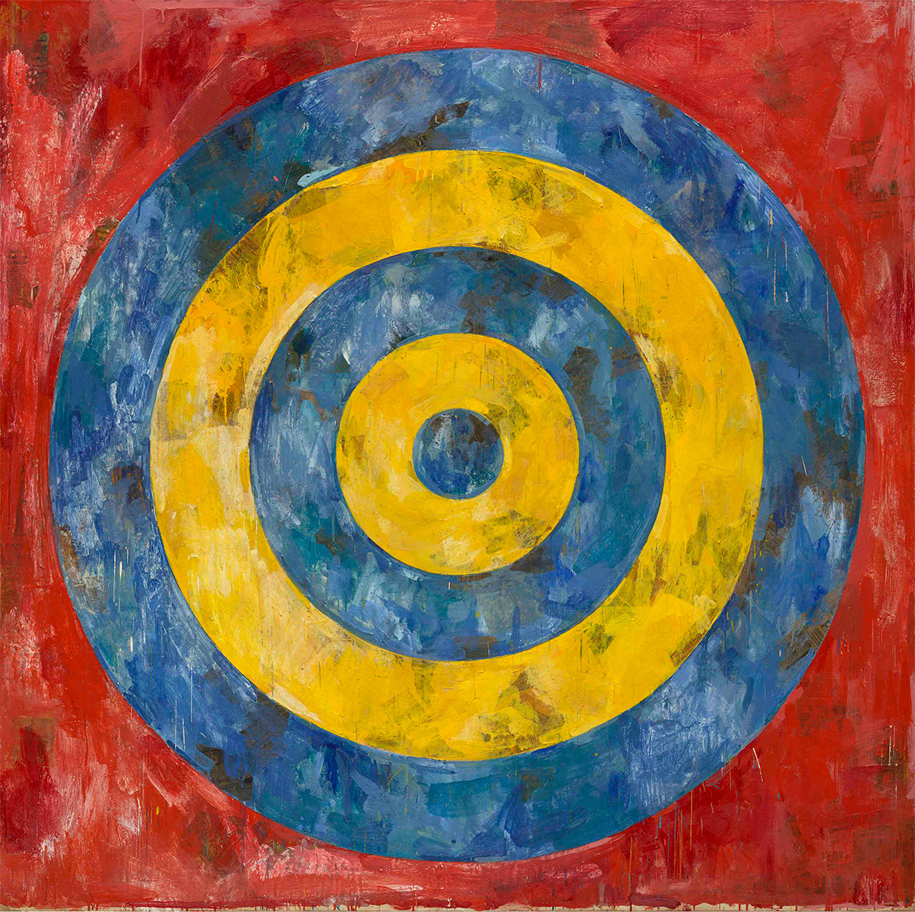
Famous Work

Slide 5
Questions
Where was Jasper Johns born?
What kind of art did he create?
What are some of his famous painting?
What is an everyday object you could turn into a painting?

Slide 6
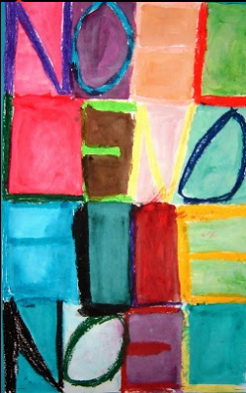
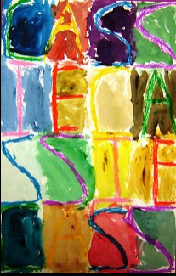
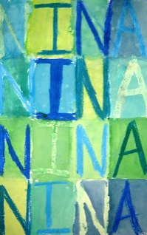
Your Jasper Johns Inspired Art

