Slide 1
Tornado in a Bottle
Science Masterpiece

Slide 3
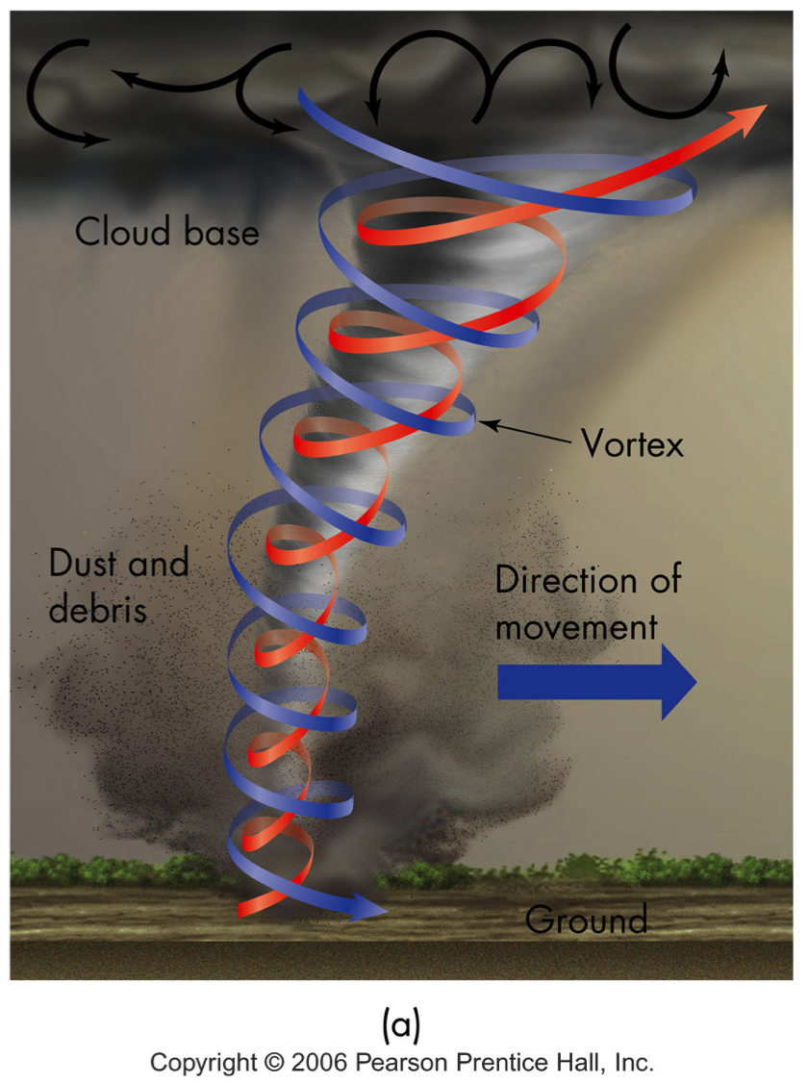
What is a Tornado?
A fast spinning, funnel shaped cloud.
It begins in a cloud and can reach all the way to the ground.
The swirling wind is a mass of air around a calm center.

Slide 4
Vocabulary
Funnel – a cone shape that narrows to a small tube at the bottom
Meteorologist – a scientist who studies the weather
Severe Weather – weather that can cause serious harm
Swirl – to spin in circles
Tornado – a violent, spinning storm
Vortex – a mass of spinning air, liquid, ect., that pulls things into it’s center.

Slide 5
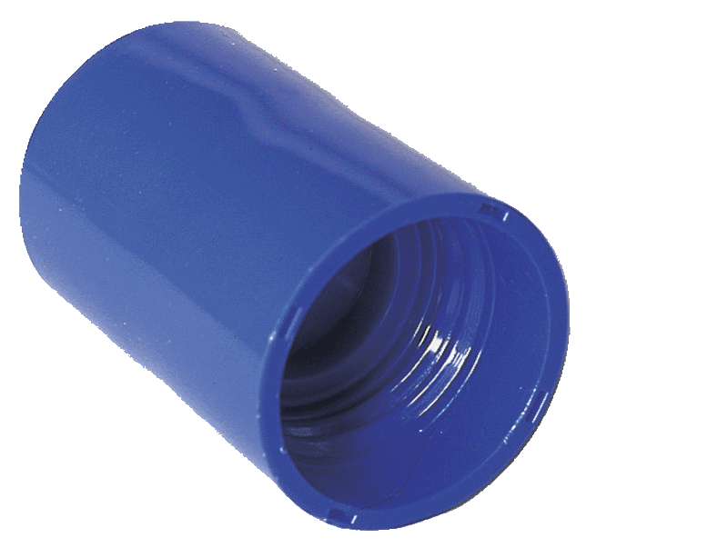
Experiment Time
Build Your Own Tornado in a Bottle
tornado tube
bottles

Slide 6
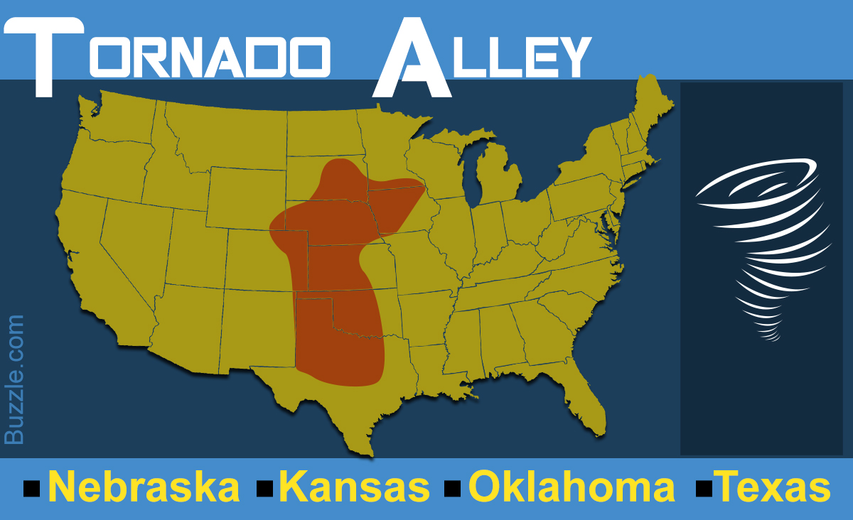
Facts About Tornadoes
Tornados have the strongest winds on earth, they can be up to 300 miles per hour and can be hundreds of feet wide. Fortunately, they only last a few minutes.
Water and debris swirling in the wind make the funnel-shaped cloud easy to see.
They usually occur during thunderstorms in the spring or summer.
Tornados are most common in Tornado Alley.

Slide 7
Observation
What happens when you swirl the bottle faster?
Does the vortex always look the same?
What happened to the glitter in the bottle?

