Slide 1
The Human Heart
Science Masterpiece

Slide 2
Link to Heart Video

Slide 3
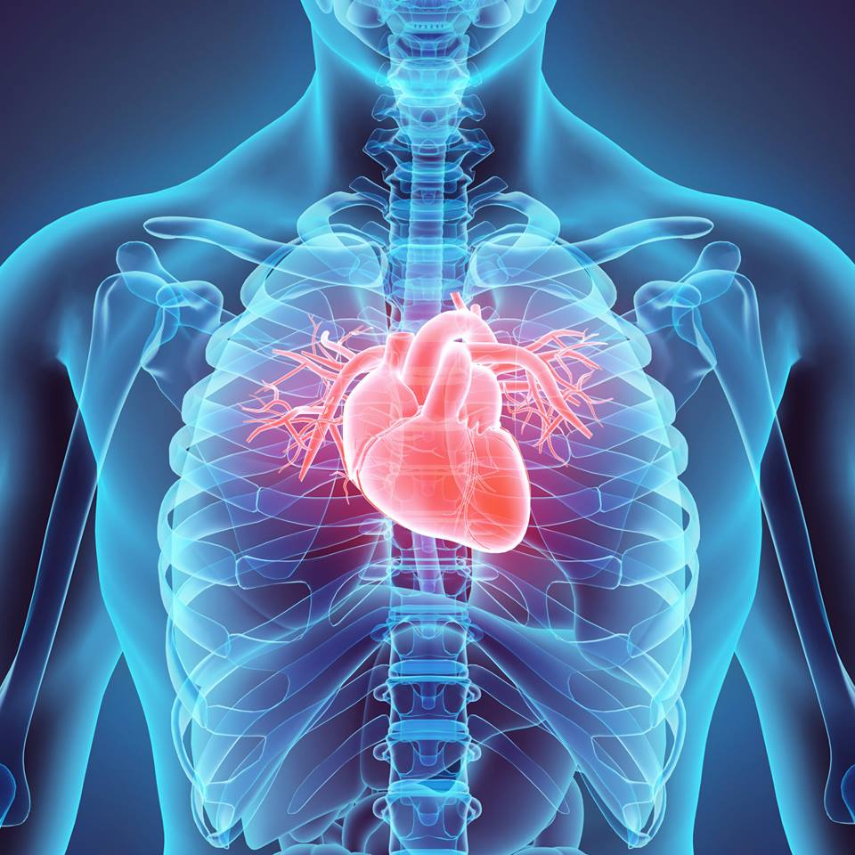
Heart Anatomy
The heart is about the size of your fist, it’s hollow and cone shaped.
It has a mass between 250-350 grams, which is less then a pound.
The heart extends from the 2nd rib to the 5th and 6th rib.
The lungs are on either side of the heart and partially hide it, it’s lying left of center in your chest.
The average adult heartrate is 60-100 beats/min.

Slide 4
Chambers of the Heart
The heart has four chambers
The two upper chambers are the Atria, there is a left and a right.
The two lower chambers are the Ventricles, there is a left and a right.

Slide 5
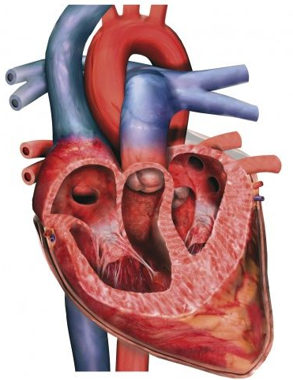
Great Vessels of the Heart
The Inferior and Superior Vena Cava are attached to the Right Atrium.
The Left and Right Pulmonary Veins are attached to the Left Atrium.
The Pulmonary Artery is attached to the Right Ventricle.
The Aorta is attached to the Left Ventricle.

Slide 6
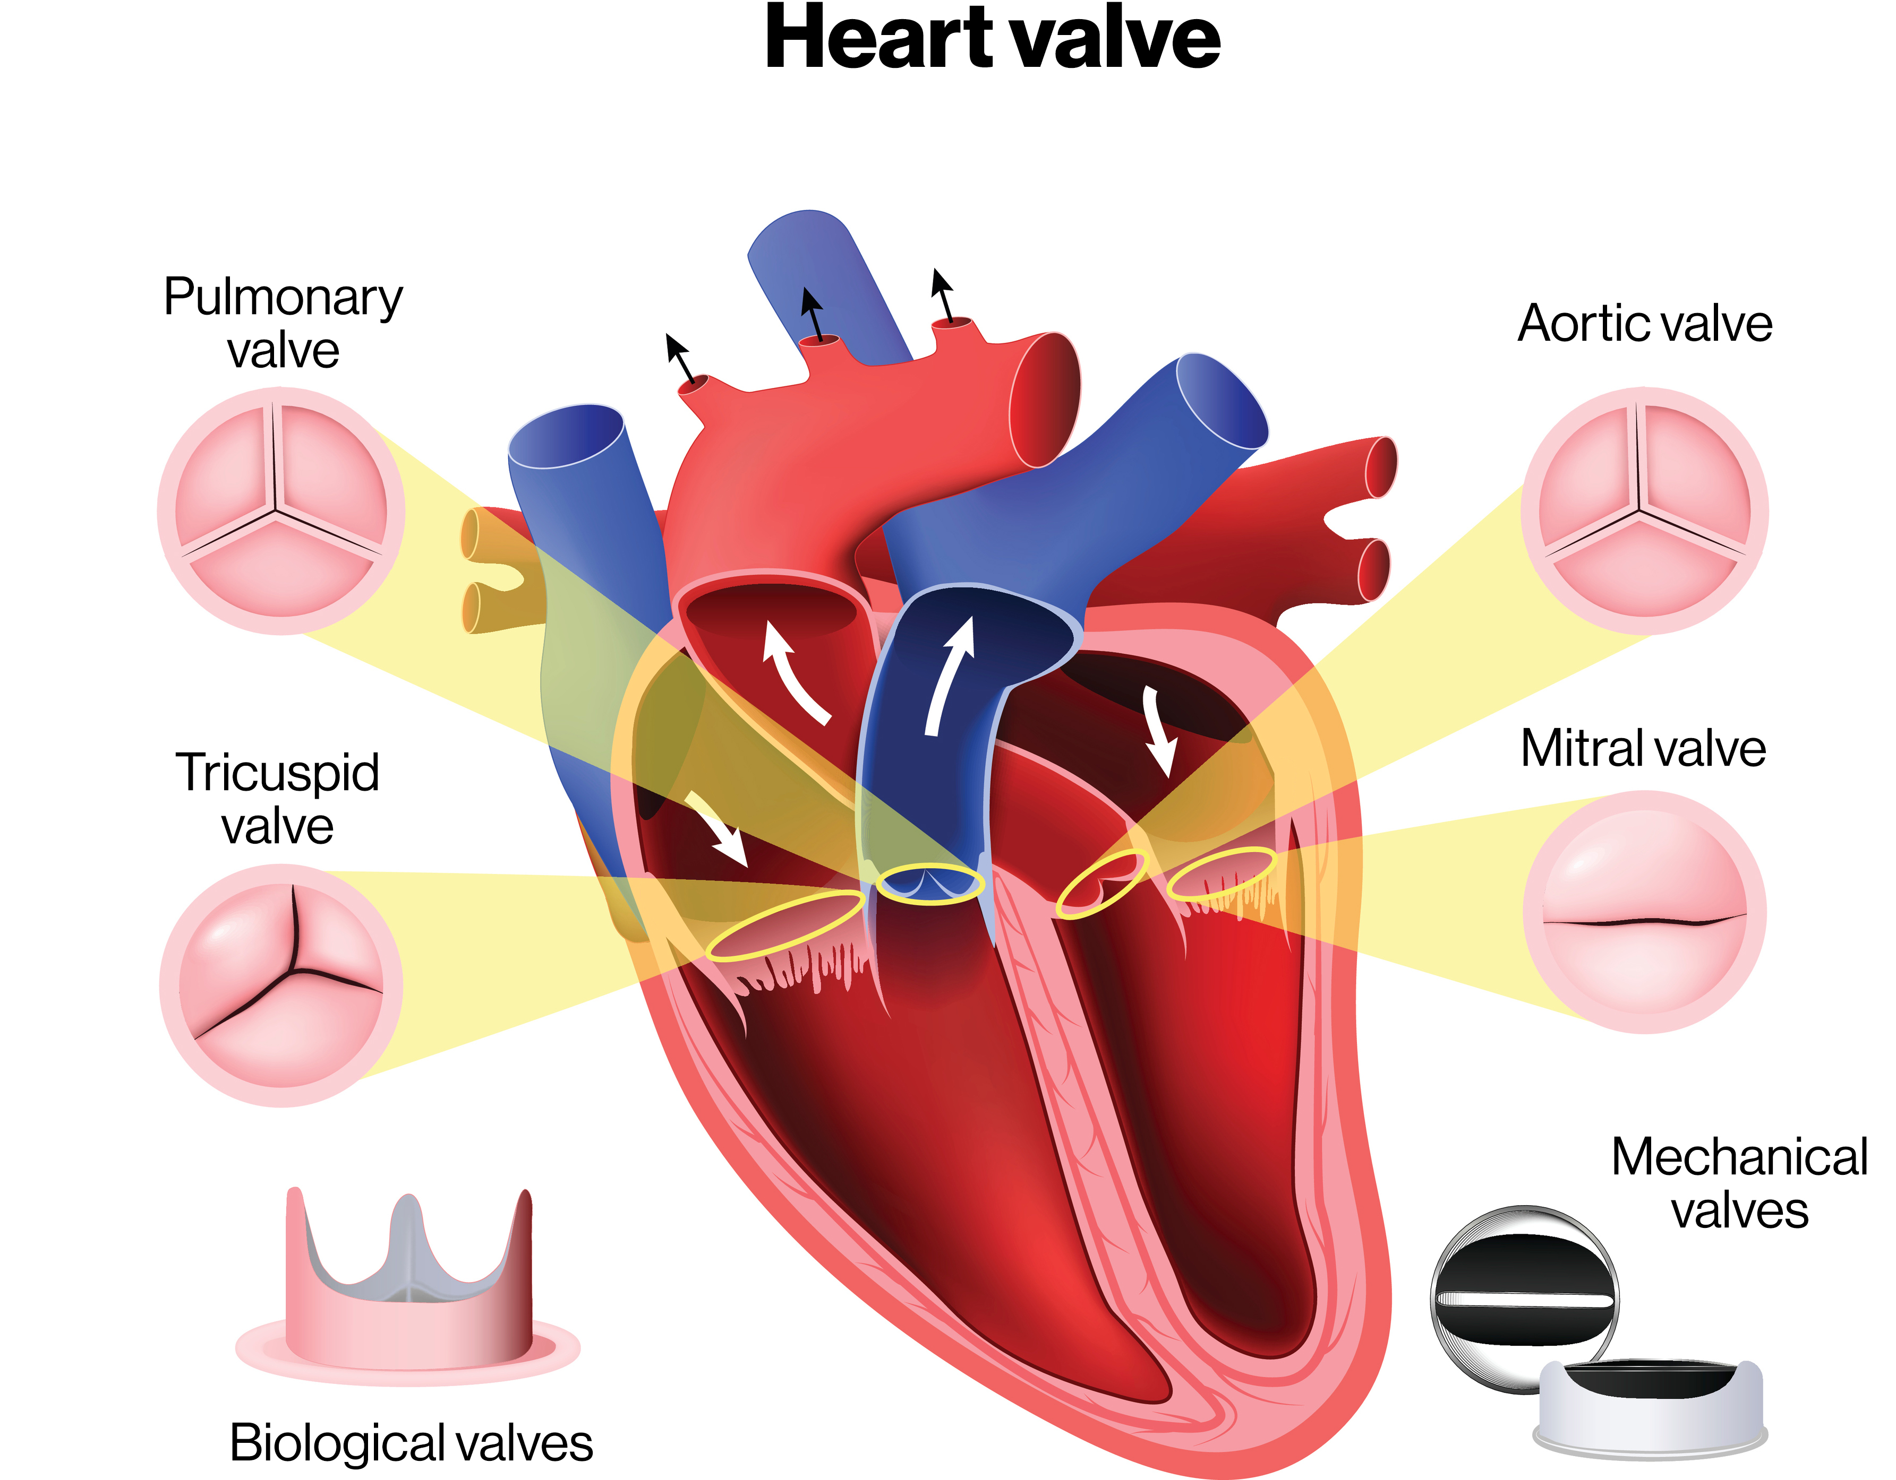
Valves of the Heart
There are two Atrioventricular(AV) valves between the Atria and Ventricles.
The AV valve on the right side of the heart is called the Tricuspid Valve, it is made up of three flaps.
The AV valve on the left side of the heart is called the Mitral Valve, it is made up for two flaps.
The valves from the Ventricles to the corresponding great vessels are called Semilunar Valves (SL).
The Right Ventricle contains the Pulmonic SL Valve.
The Left Ventricle contains the Aortic SL Valve.

Slide 7
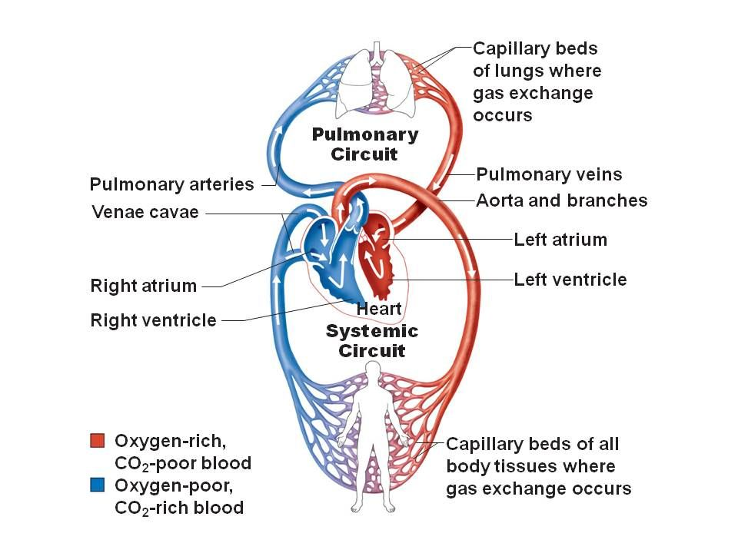
Blood Flow of the Heart
The function of the heart is to pump blood high in oxygen to all parts of your body.
When the oxygen is all used up, the blood returns to the heart to get pumped to the lungs to pick up more oxygen.

Slide 8
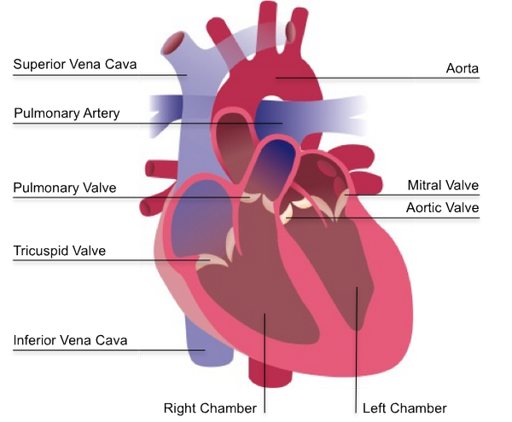
Blood Flow From Lungs to the Heart
Blood low in oxygen returns to the Right Atrium through the Vena Cavae.
Then it goes to the Right Ventricle and out of the Pulmonary Artery to the lungs.
After it picks up oxygen in the lungs, blood flows through the Pulmonary Veins to the Left Atrium.
Then it goes to the Left Ventricle and out of the Aorta to the body.
Then the process repeats.
Pulmonary Veins

Slide 9
Link to Lub Dub
Heart Beat: Lub Dub

Slide 10
Build Your Own Heart

Slide 11
