Slide 1
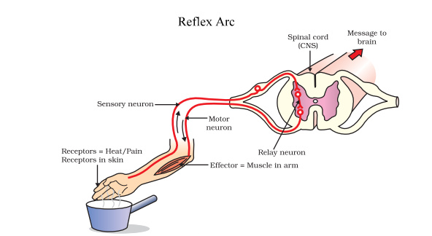
Reflexes and Reaction Time Science Masterpiece

Slide 2
INDUSTRY OUTLOOK
Nervous System and Reflexes Video Link

Slide 3
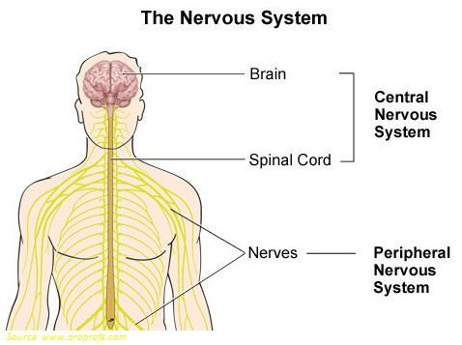
Nervous System
The Nervous System is the control center of the body. It is made up of the brain, spinal cord, and the nerves. The Nervous System processes information from the body and controls how the body reacts and moves. It does this through millions of nerves that are located all over the body.
The Nervous System can be divided into the Central Nervous System (CNS) which is made up of the brain and spinal cord. And the Peripheral Nervous System (PNS) which is made up of nerves through out the body.

Slide 4
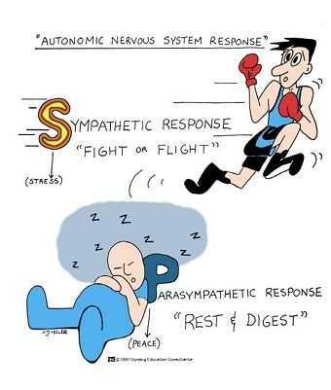
Peripheral Nervous System
The PNS can be further divided into the Somatic Nervous System (SNS) and Autonomic Nervous System (ANS). These translate into “voluntary” and “involuntary” respectively.
The ANS can be dived Parasympathetic and Sympathetic Nervous Systems based on the type of involuntary responses each generates. The Sympathetic Nervous System is responsible for “Fight or Flight” type reflexes. The Parasympathetic Nervous System is responsible for “Rest and Digest” type reflexes.

Slide 5
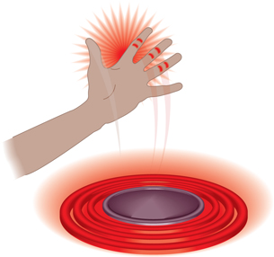
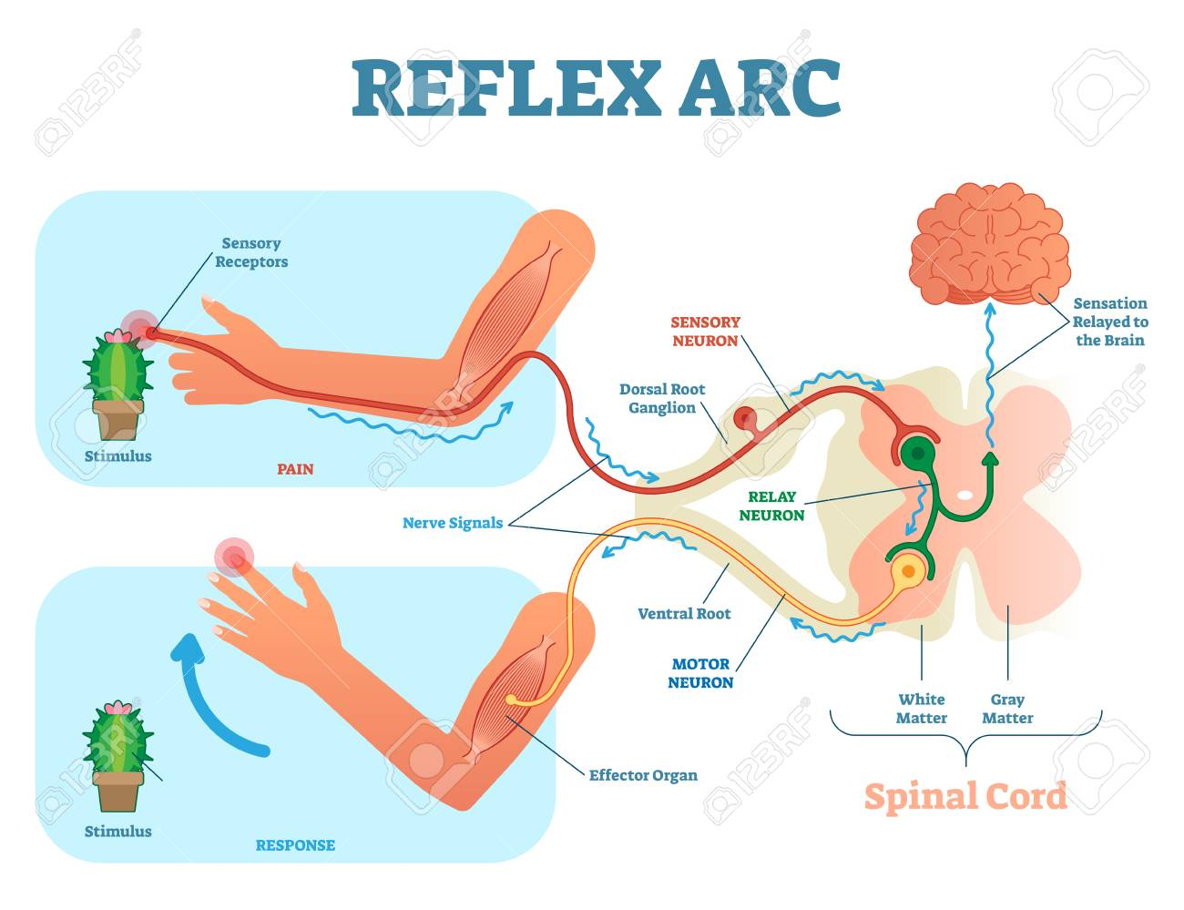
Reflexes
Sometimes your body reacts to something before your brain even knows about it!
For example, if you touch a hot stove, the nerves in your fingertips sends a message to your spinal cord which instantly sends a message back telling your muscles to move away. By the time your brain becomes aware of the danger, your hand is already safe.
These automatic reactions are called Reflexes. Because the nerve messages take a short cut to the spinal cord and back, without going all the way to the brain, the reaction time for a reflex is very fast. Those that involve the brain, such as playing a video game, take longer.

Slide 6
Experiment Time
Test your neighbor’s reaction time.
One person will be the dropper and the other will be the catcher.
The dropper will hold a ruler at the top (by the highest number).
The catcher will hold his or her hand 1inch below the ruler, with the thumb and fingers open and ready to catch the ruler by pinching it.
Without warning, the dropper will drop the ruler, and the catcher will try to catch the ruler. The catcher will hold the ruler where it was caught.
Record the place where the ruler was caught on the Reaction Time chart.
Repeat this experiment 8 times.
Switch Dropper and Catcher.

Slide 7
Conclusion
Did your partner's reaction time improve the more times you did the experiment? Why do you think that happened?
Do you think reaction time is important to a baseball player? Why or why not?
Clap your hand in front of your partner’s face. What did you observe?
Have your partner close their eyes for 10 seconds then quickly open them. Did you notice any changes with their pupils?

