Slide 1
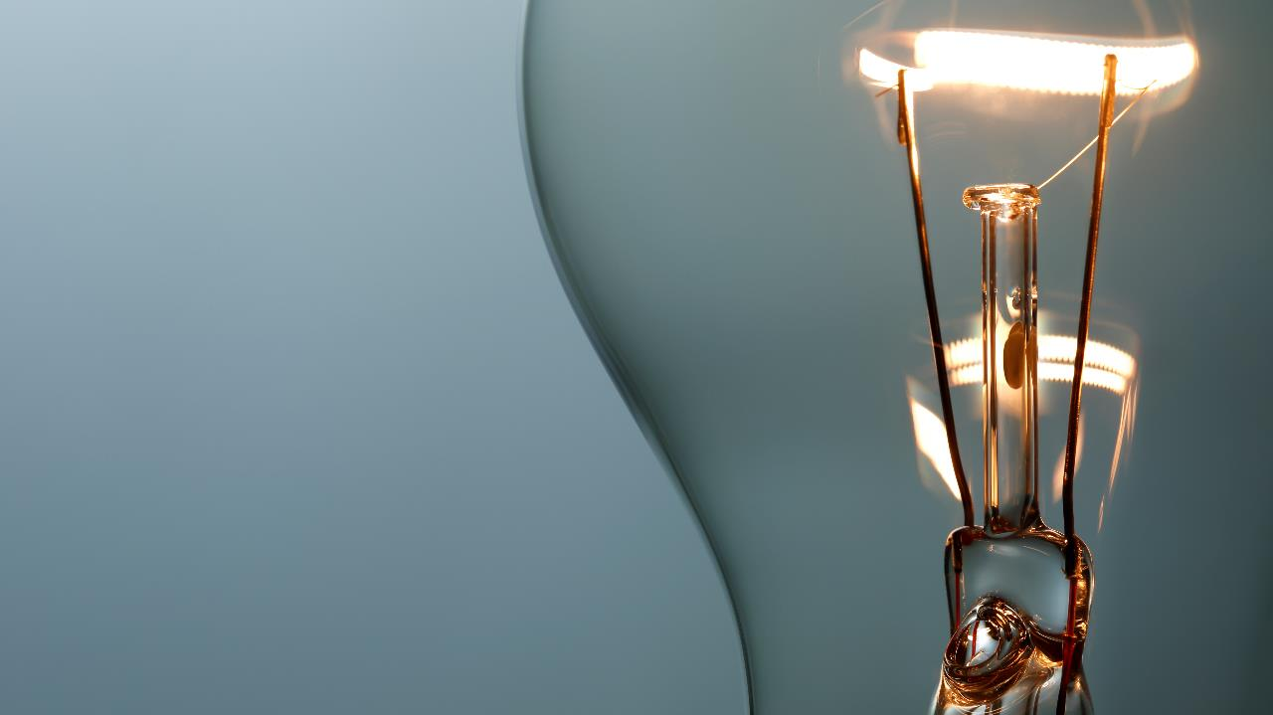
Can You create electricity?
Science Masterpiece

Slide 2
Link To Static Electricity Video

Slide 3
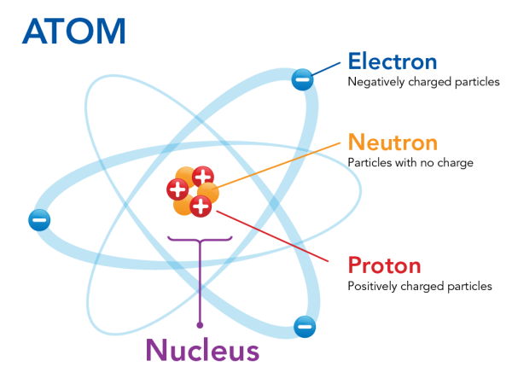
All matter has atoms that contain an electrical charge.
Most of the time it’s balanced, but when we rub 2 objects together, we get an imbalance…STATIC ELECTRICITY.
The excess negative particles in the balloon are now attracted to the positive particles in the wall.

Slide 4
Vocabulary
Attract – to pull or draw in
Repel – to push away
Electrical Charge – the positive and negative charges found in matter
Electricity – a form of energy that occurs from the movement of electrons from one atom to another
Static Electricity – a buildup of the electrical charge on the surface of an object

Slide 5
Experiment Time

Slide 7
Conclusion
Static electricity happened when charged particles moved from one object to another.
When you rubbed the balloon on your hair, the negative particles in your hair moved to the balloon leaving an excess of positively charged particles in your hair, causing it to repel one another, making it stand up.
When the rubbed balloon was over the paper circles, they attracted the positive particles in the paper.
When you rubbed the spoon with the wool cloth, you built up negatively charged particles on the spoon and it attracted the positive particles in the pepper. But since salt is heavier, the static electricity couldn’t lift it as easily.

Slide 8
Questions?
Can you see static electricity?
Why do you think your hair stood up?
What is the smallest particle of matter called?
What are the 2 charges in an atom that cause it to have an electrical charge?

